Slide 1
A Walk In The Woods at
Camp Timberledge
Beach Lake, PA www.camptimberledge.org
Dr. David S. Barnes abarnes2@rochester.rr.com
July, 2014

Slide 2
Presentation Outline
Website resources
Map
Fast Facts
Water
Land
Arboretum
Plants of the Arboretum
Animals of Camp Timberledge

Slide 3
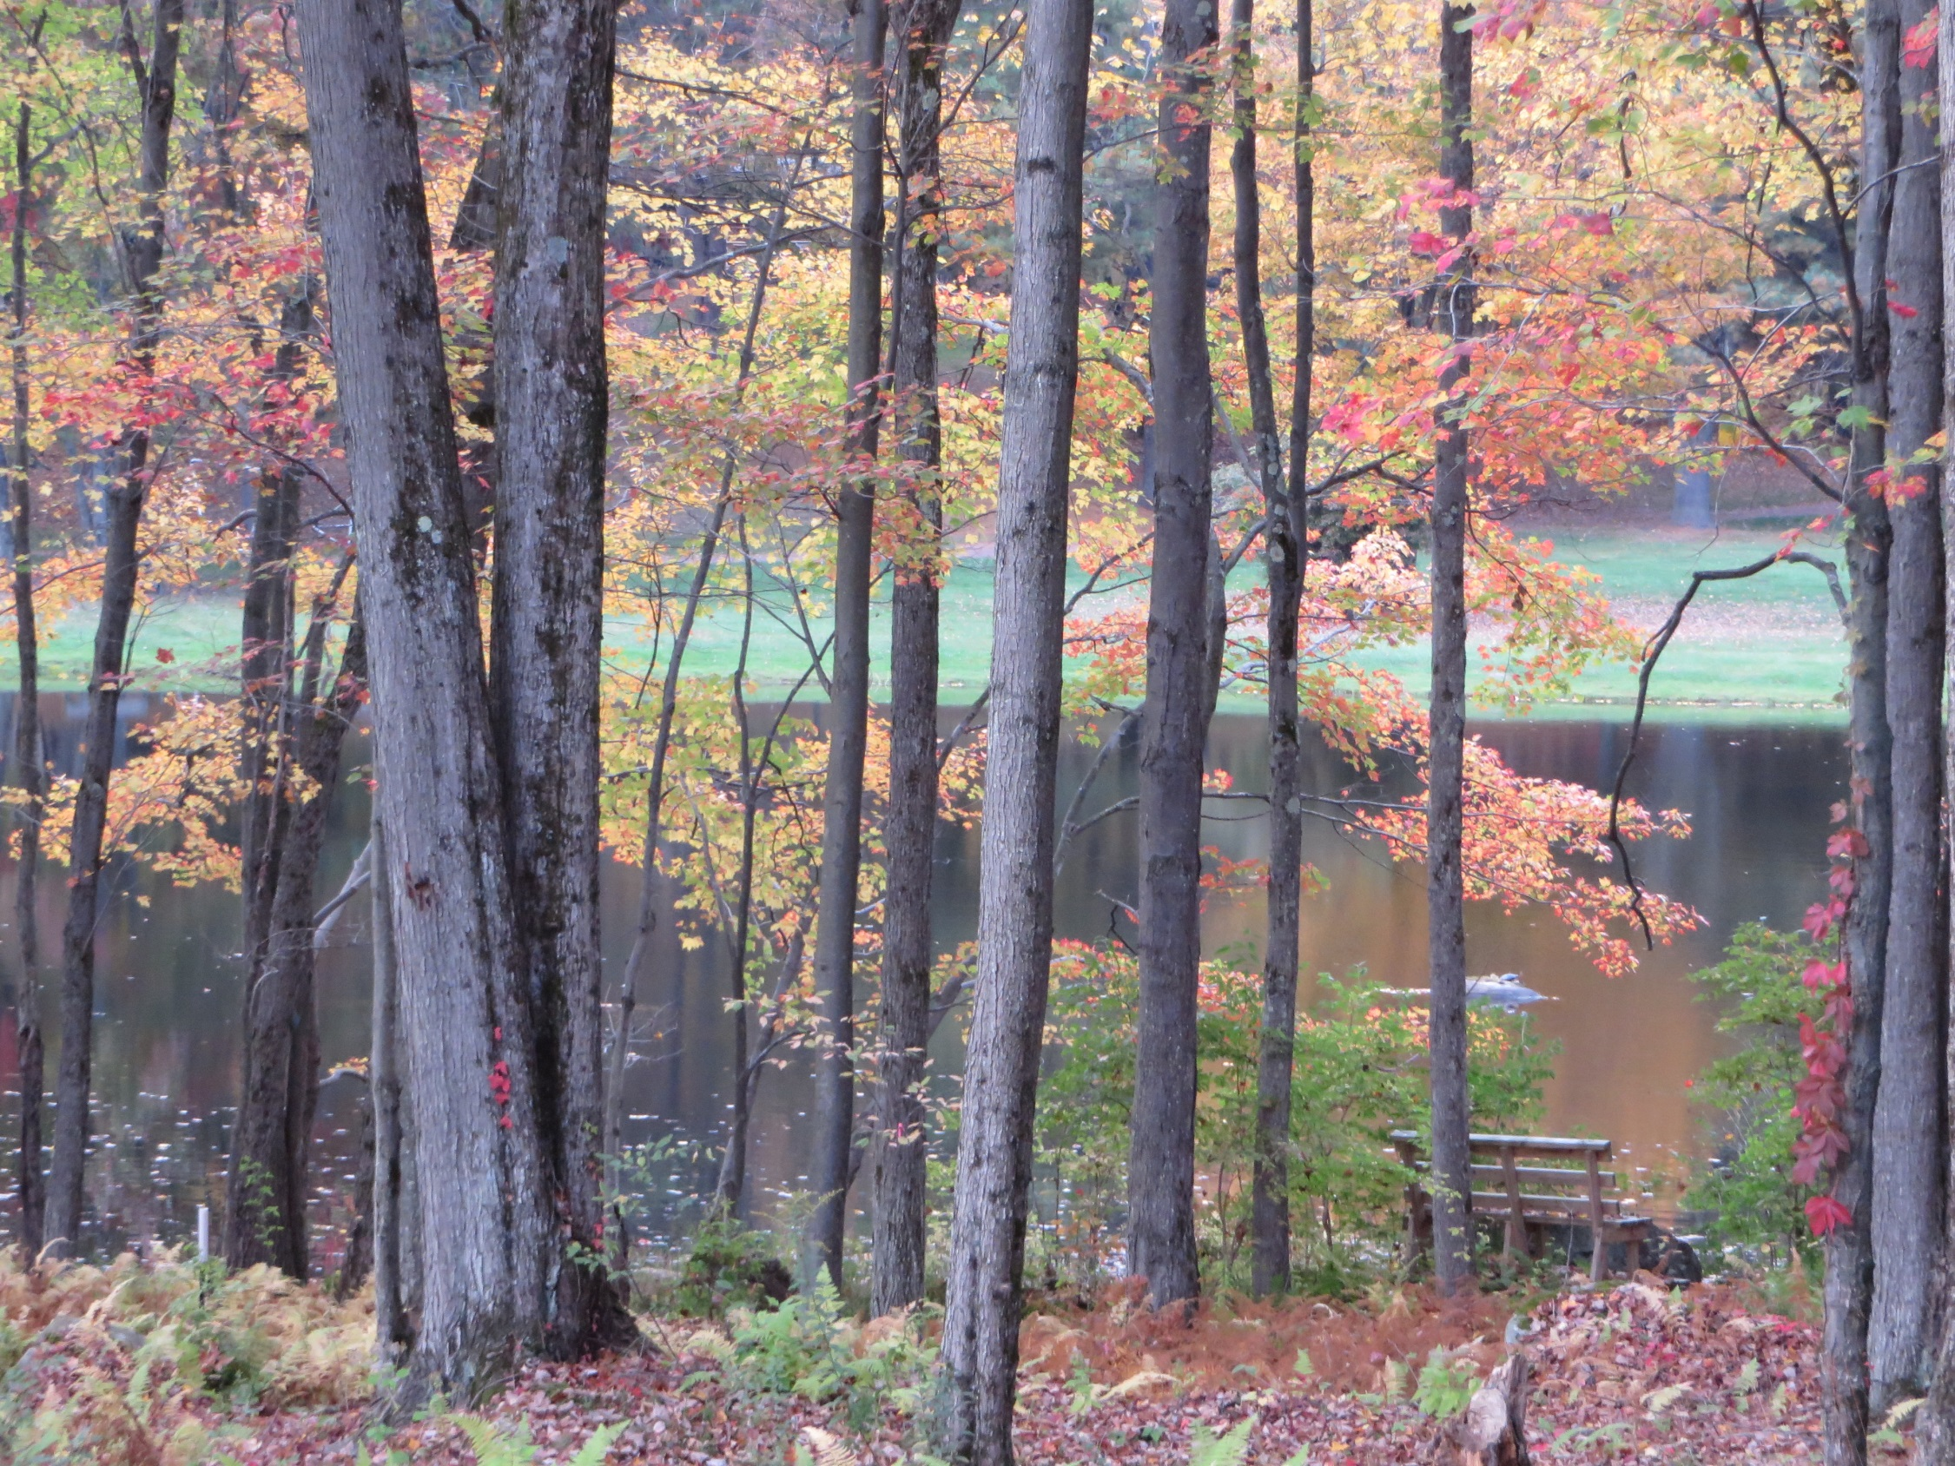

Slide 4
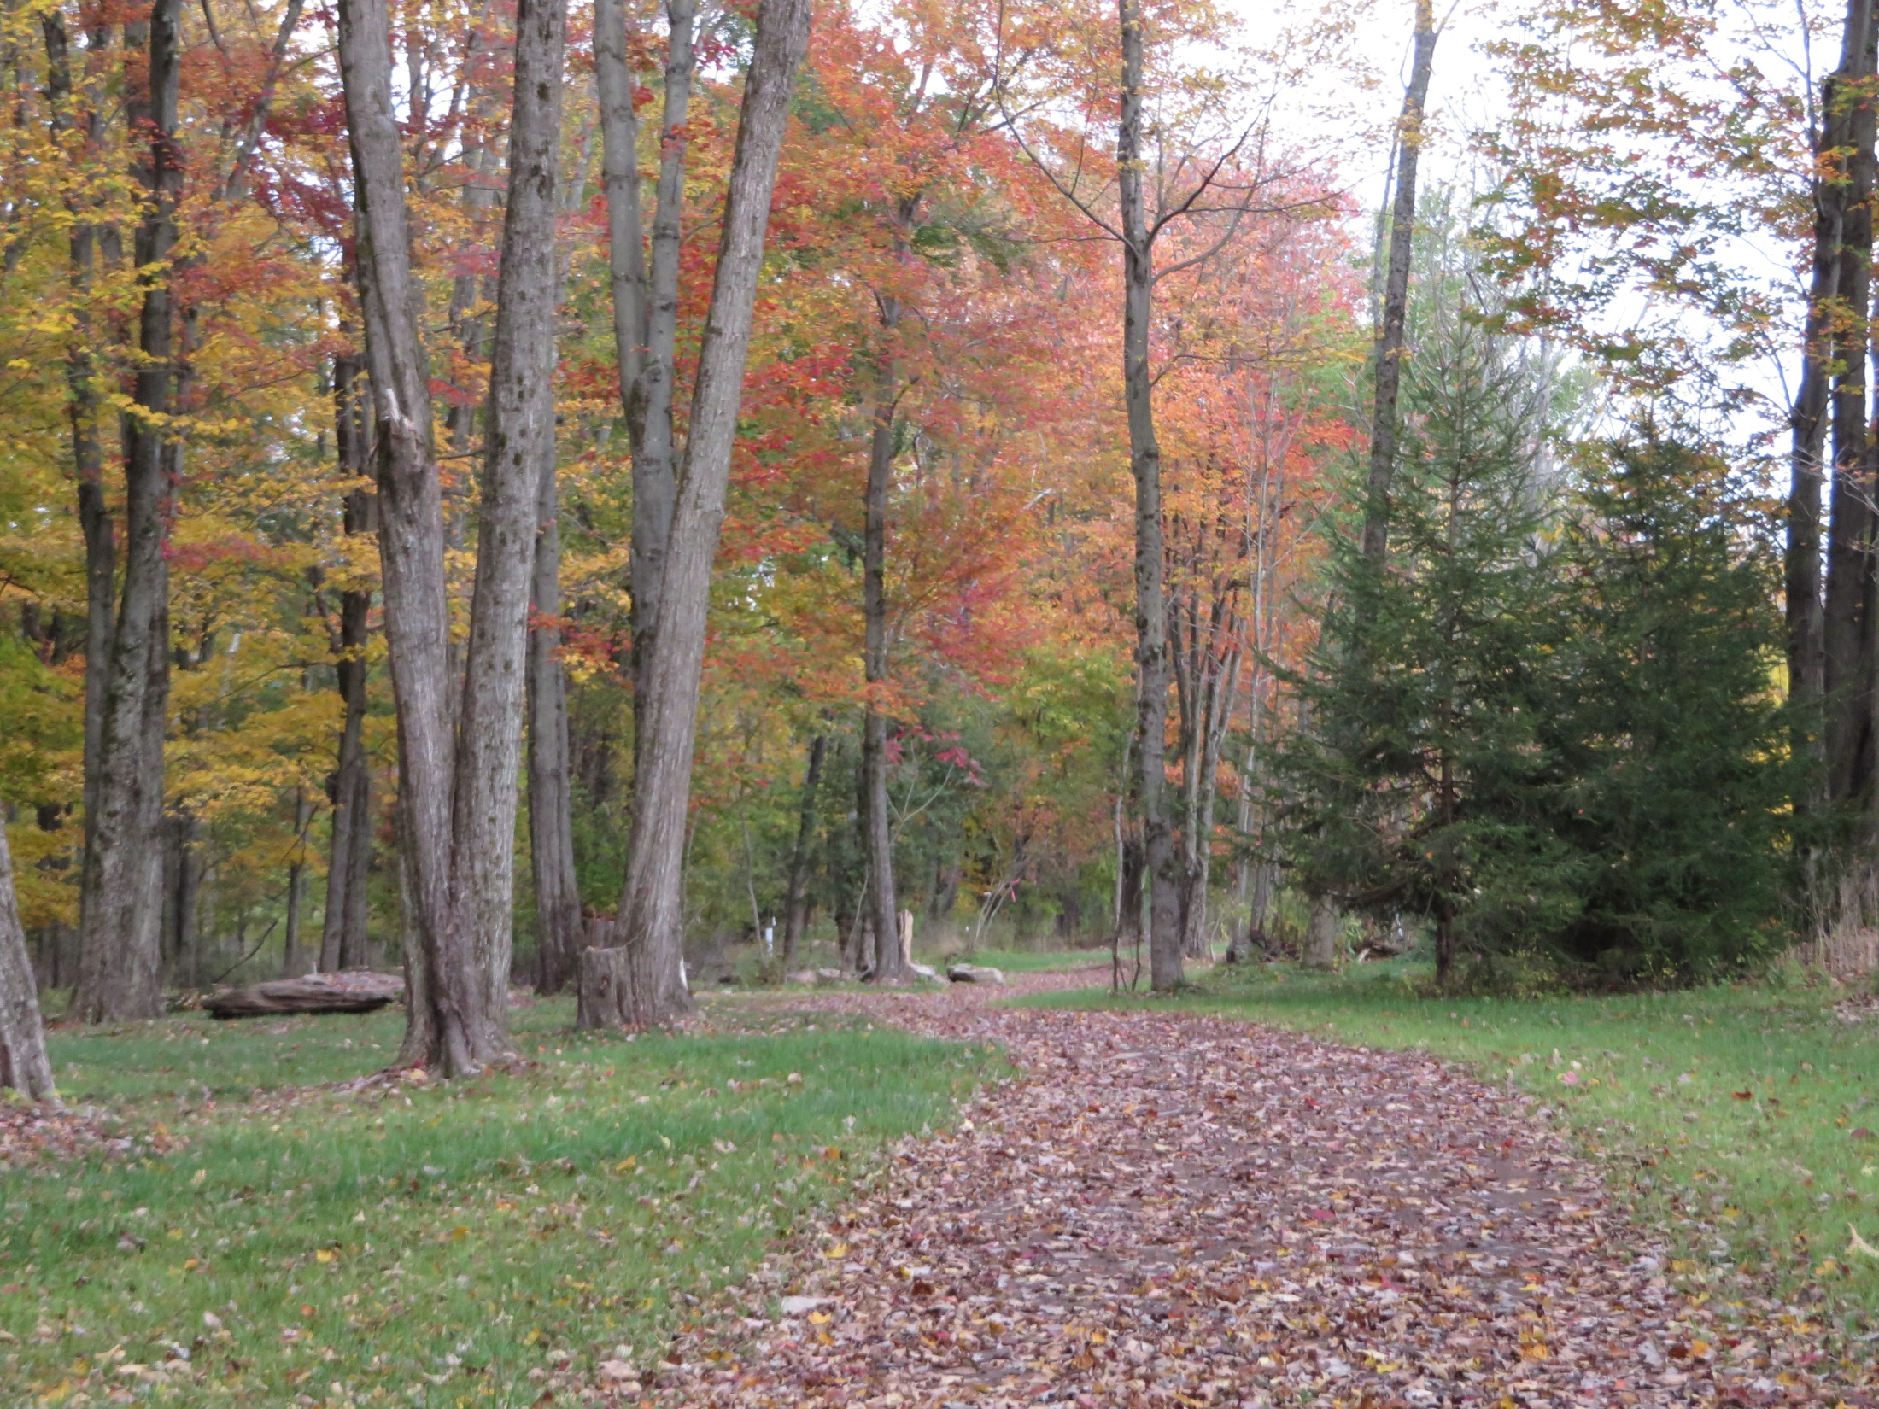

Slide 5
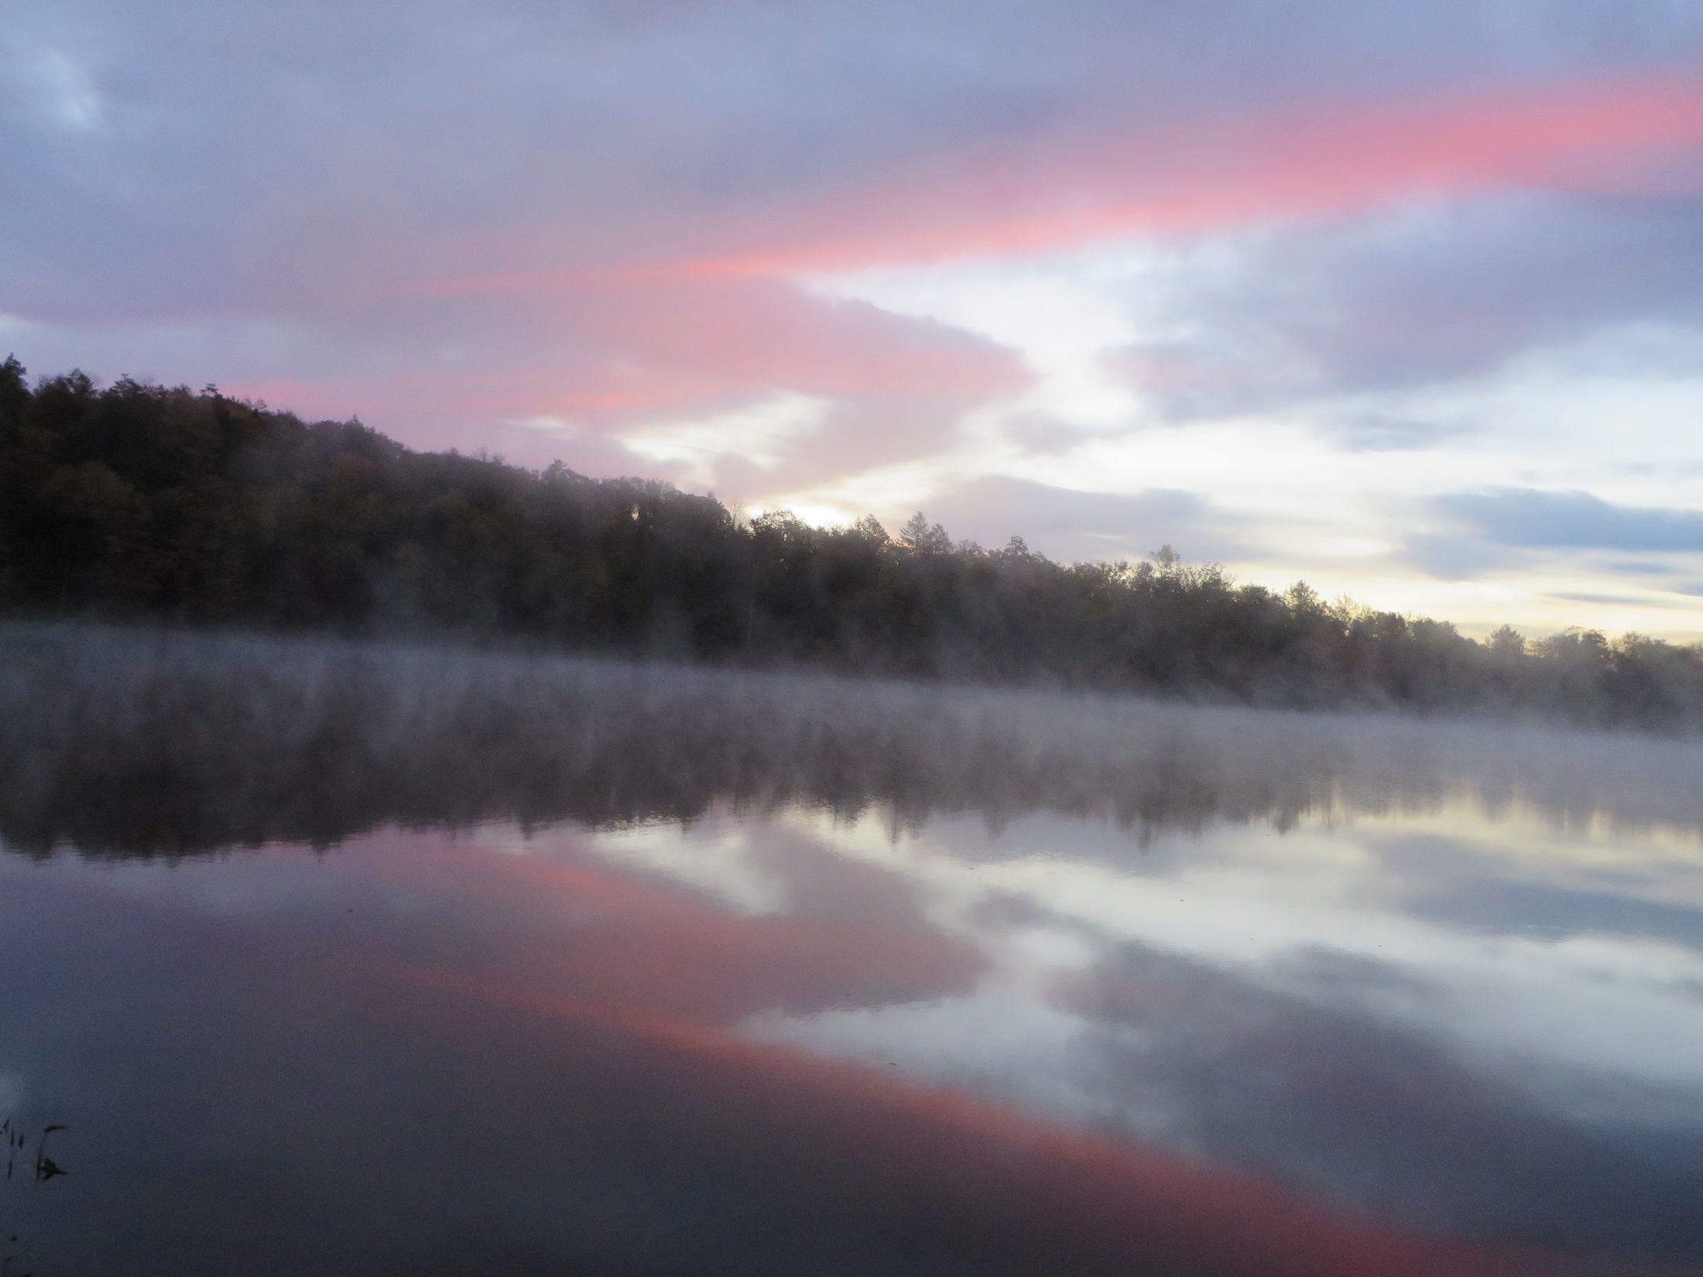

Slide 6
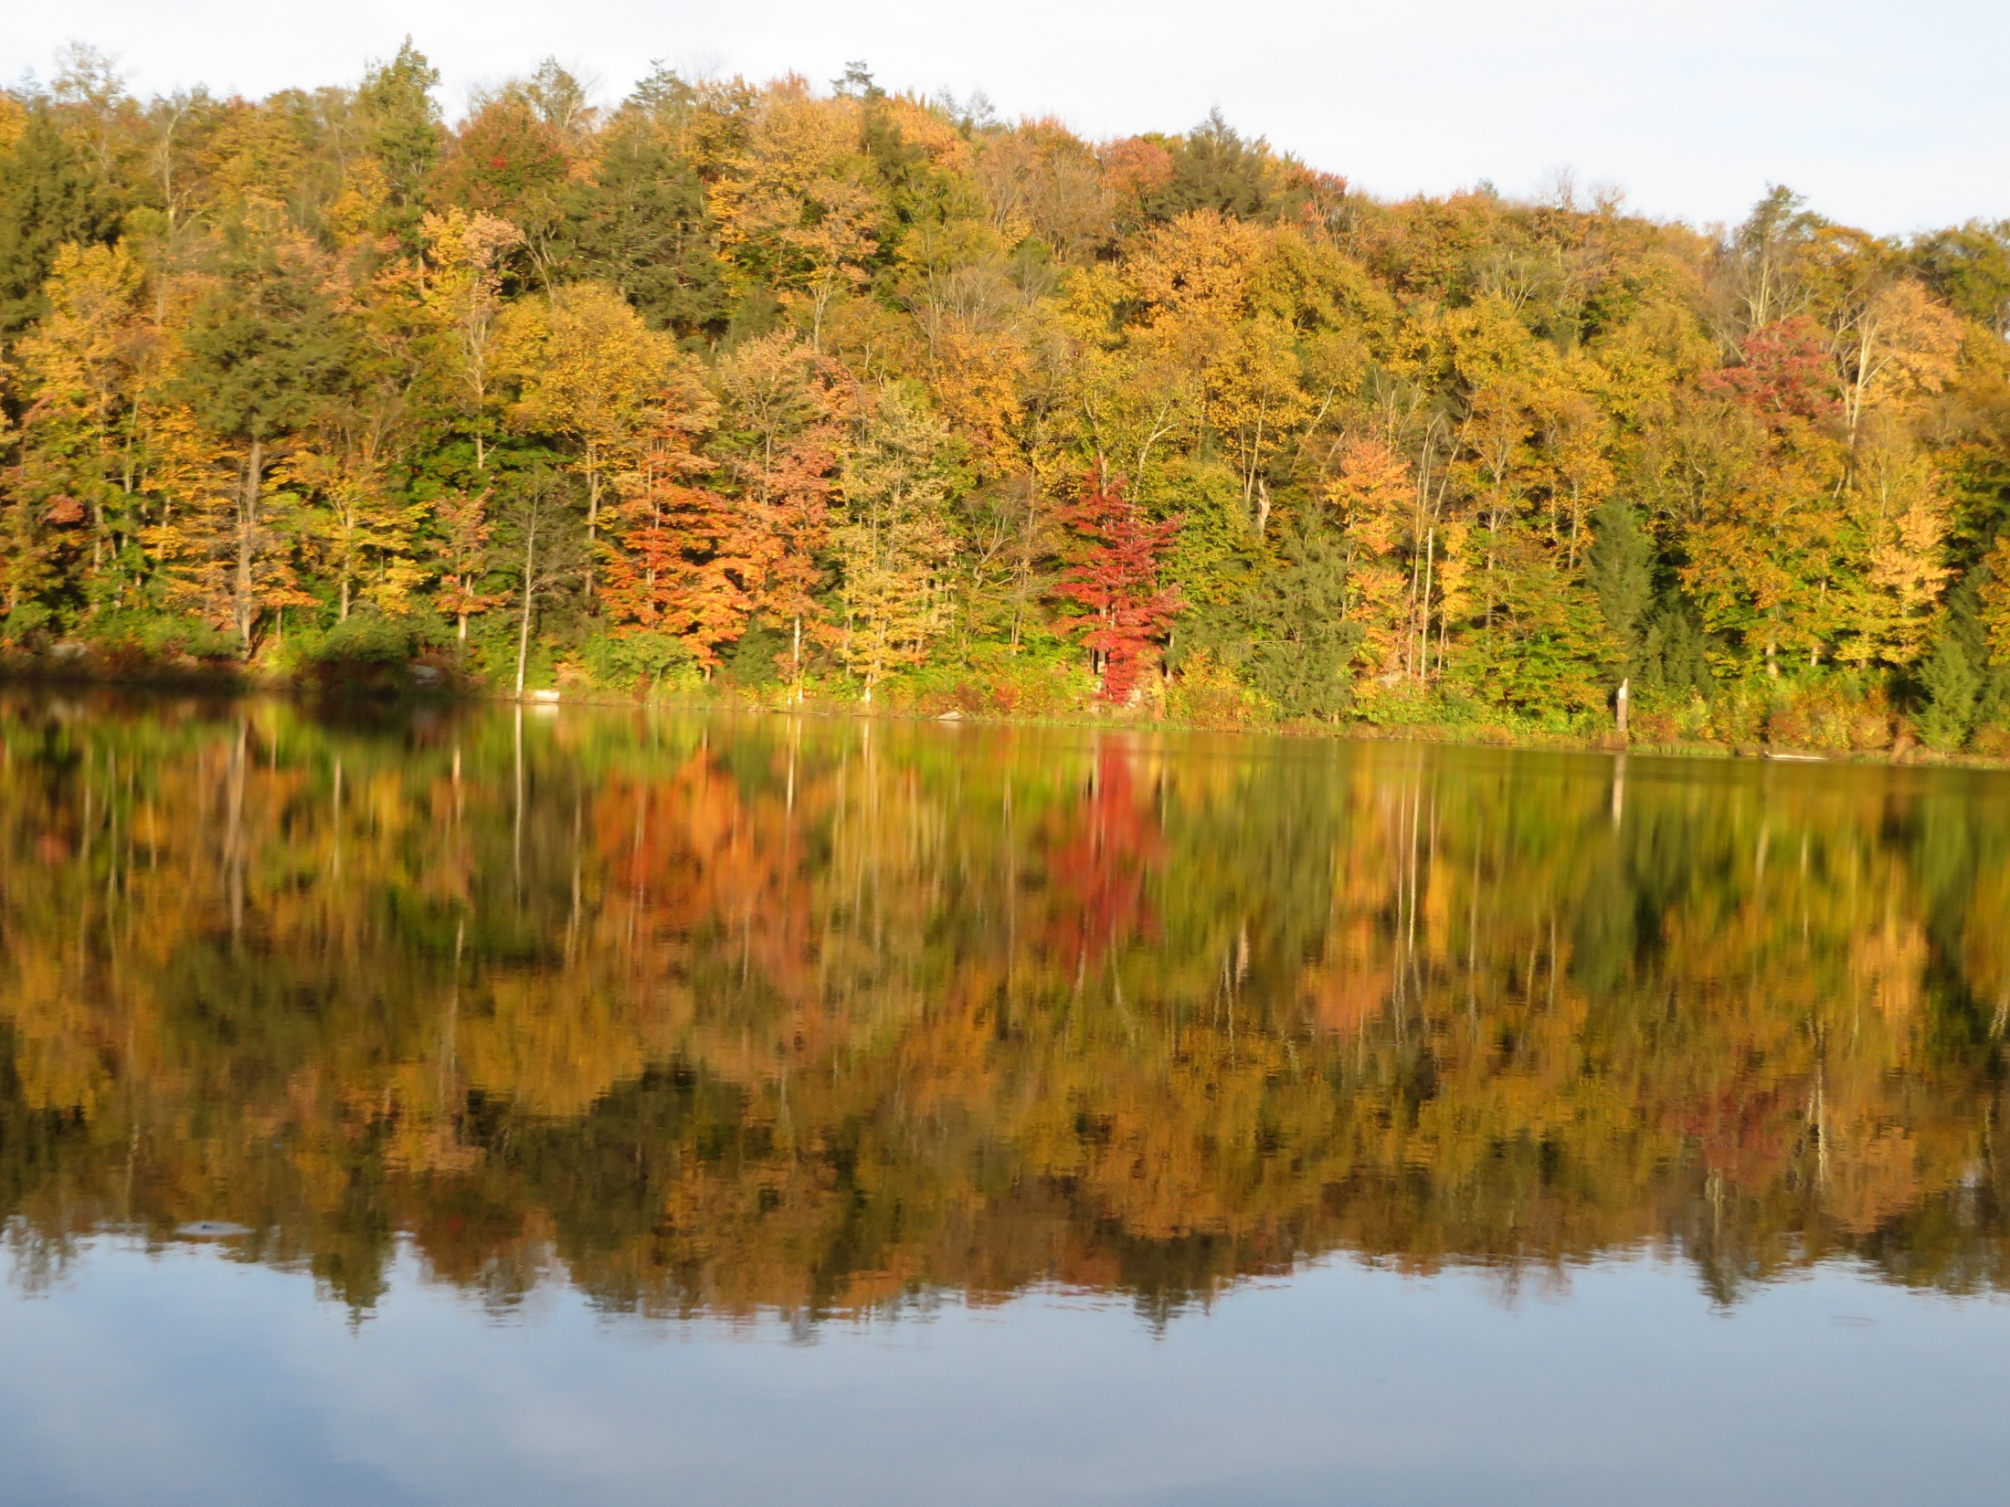

Slide 7
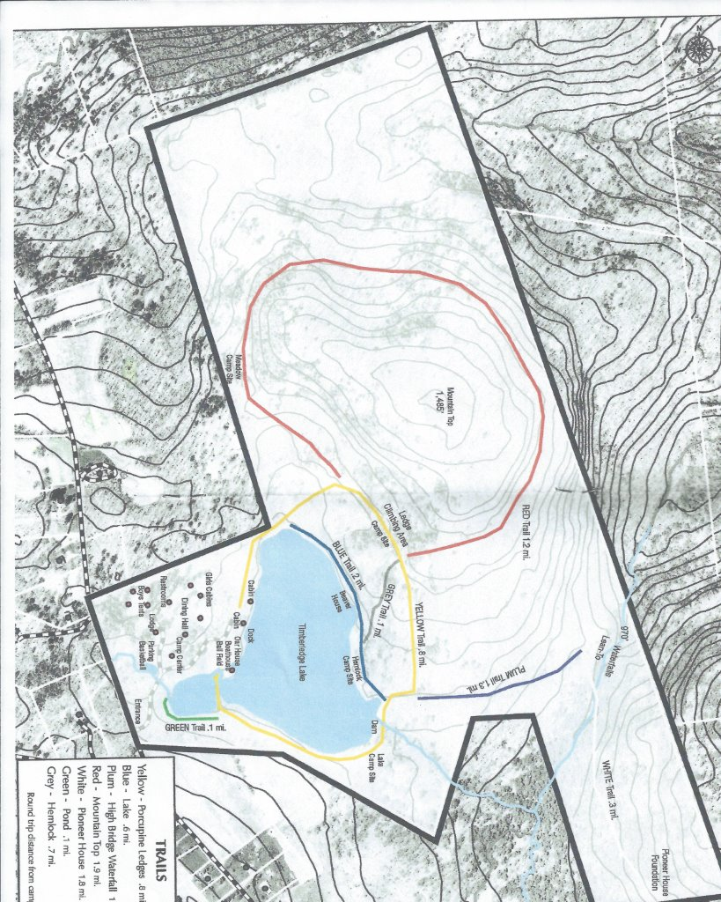
Arboretum

Slide 8
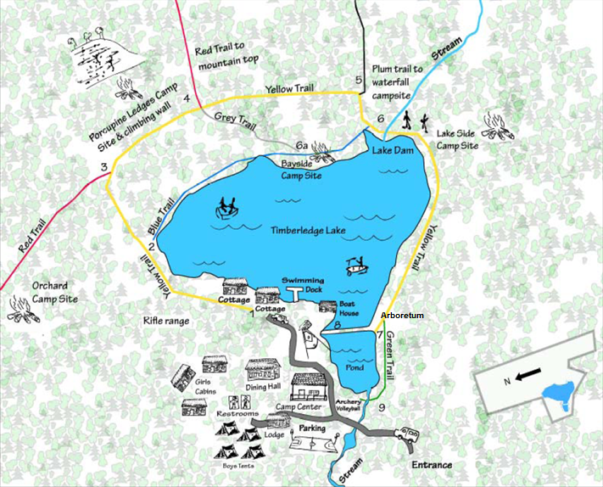
Fast Facts III.
Arboretum

Slide 9
C. Fast Facts 1.
Altitude: Mountain top is 1485 feet above sea level, lowest level is 970 feet at the base of the waterfall.
Elevation change: about 515 feet (Empire State Building 1250)
Camp size – 270 acres.
Lake size – 20 acres, depth 8-10 feet.
Pond size – 1 acre, depth 8 feet near dam.
Upper pond size - 1/8 acre, depth 6-8 feet.
Five vernal ponds – dry to 3 feet depth.

Slide 10
Fast Facts 2.
Forest type – commonly called a Northern Hardwood Forest with trees such as maples, beech, birches, and white ash.
Rock types – mostly Sedimentary
  Sandstone from compressed sand and
  Shale from compressed mud
Fish – Large mouth bass, sunfish, pickerel, bullhead
For a comprehensive listing of flora and fauna see the PowerPoint – “Life at Camp Timberledge” or “Checklist of Animals and Plants at Camp Timberledge.

Slide 11
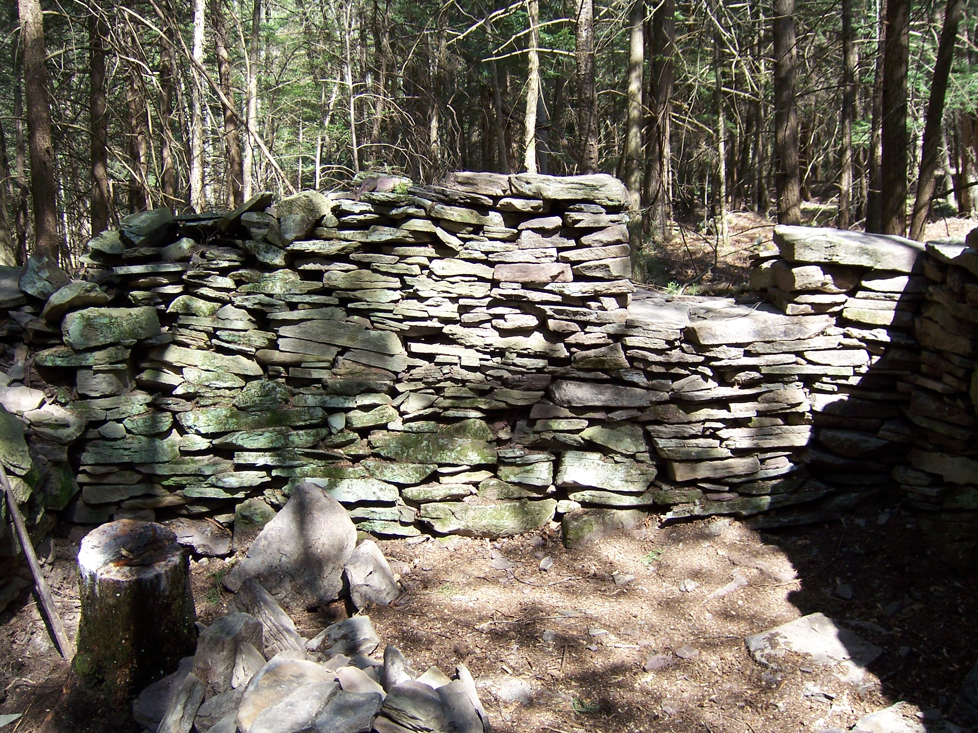
Fast Facts 3
Initial Camp land purchase 1850 by James A. Olver from Liscard, Cornwell, England – land essentially as the Indians left it.
Lake formed 1930’s, Pond 1950’s, upper pond 1980’s.
Camping Program for children/youth – started in mid 1950’s
Buildings:
One room stone house - 11’x13’, first building on present camp
property, built in 1850’s, in forest near waterfall, walls being restored.
  Lodge and Ice House 1930’s.
  Dining Hall, Chapel (now Cabin)
  and Buck/Doe 1950’s.
  Boat House 1960’s.
  Camp Center 1980’s.
  Cabins 2000’s.
  Lodge, Buck & Doe, Chapel & Camp
  Center refurbished 2000’s.
Pioneer stone house wall

Slide 12
D. Water
Lake
Ponds
Bridges
Streams
Waterfalls
Spillways
Fords
Water bars
Vernal Ponds
Springs
High Bridge

Slide 13
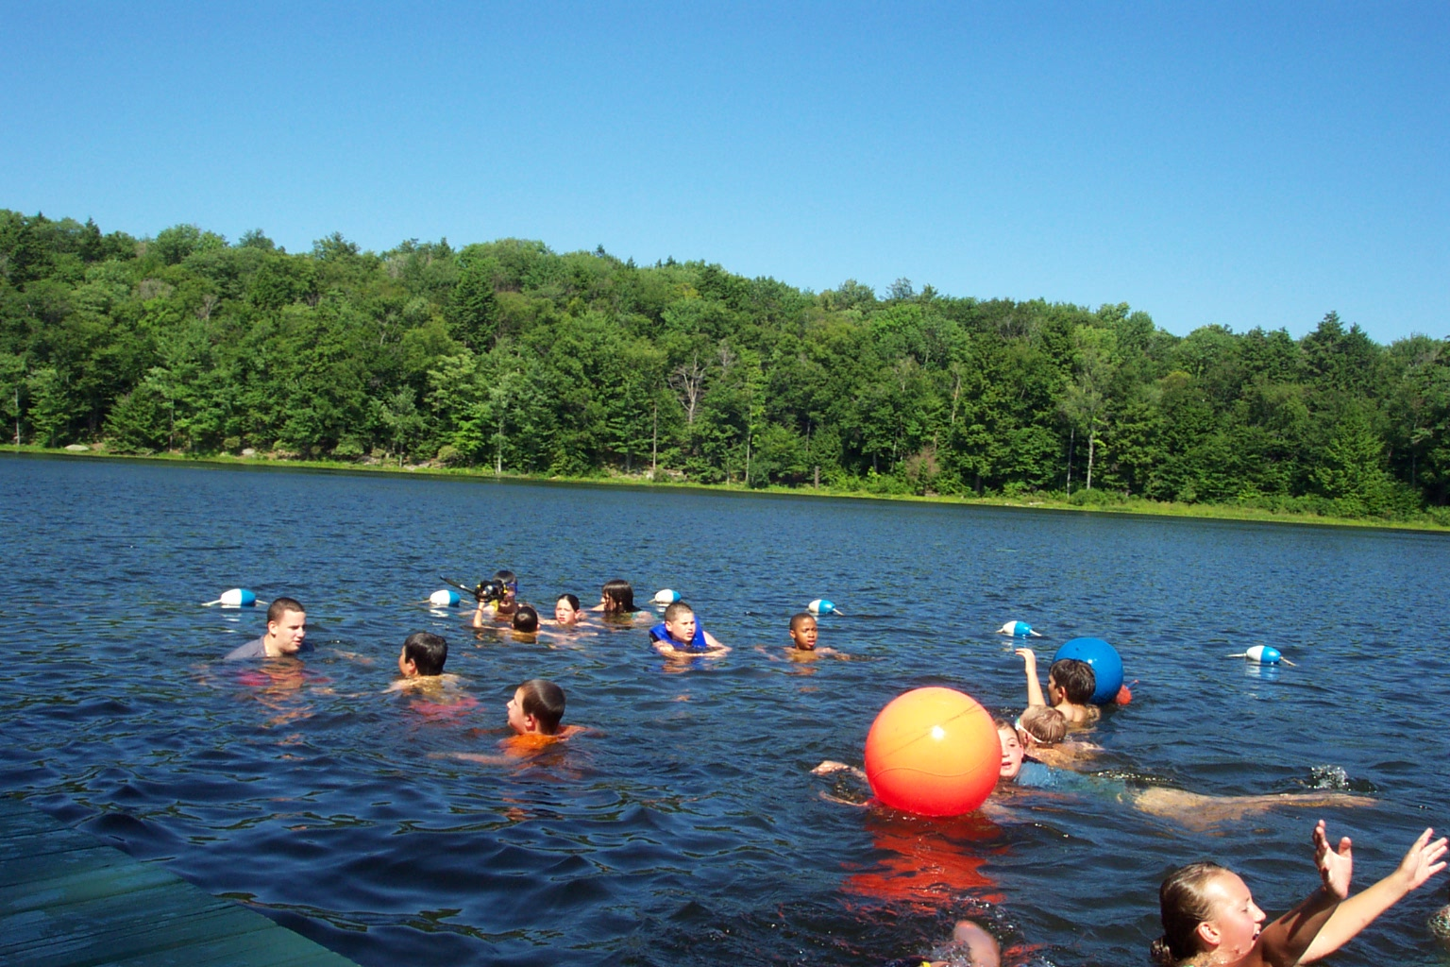
1. Lake

Slide 14
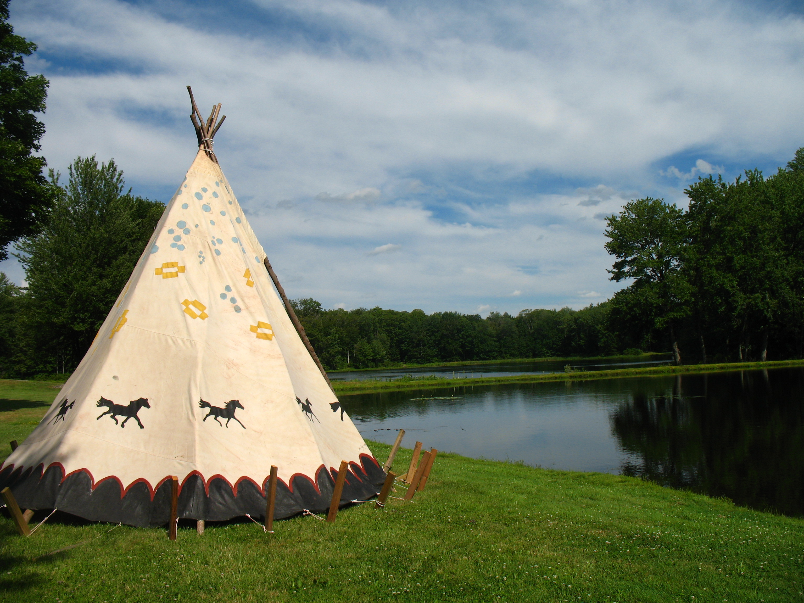
2. Pond

Slide 15
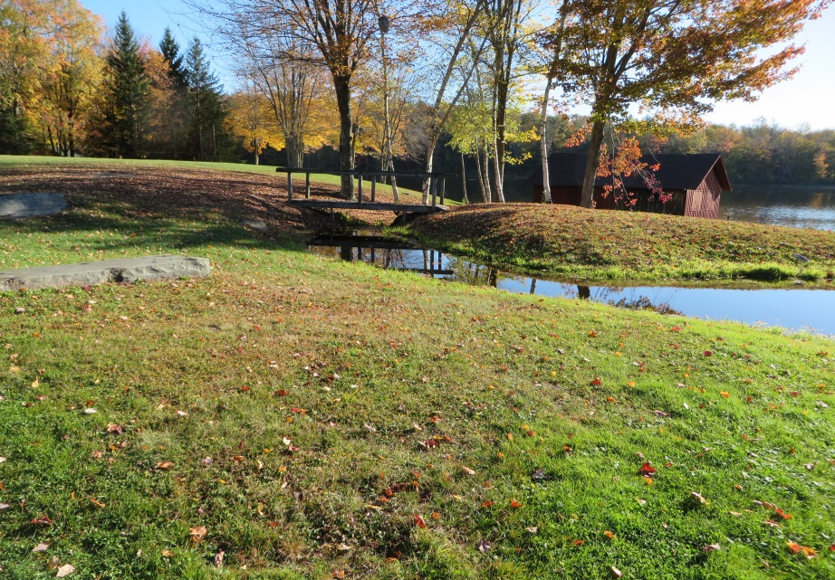
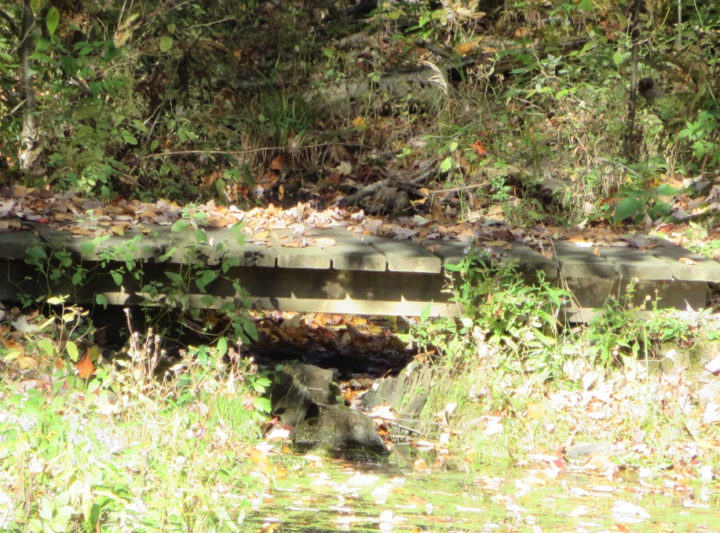
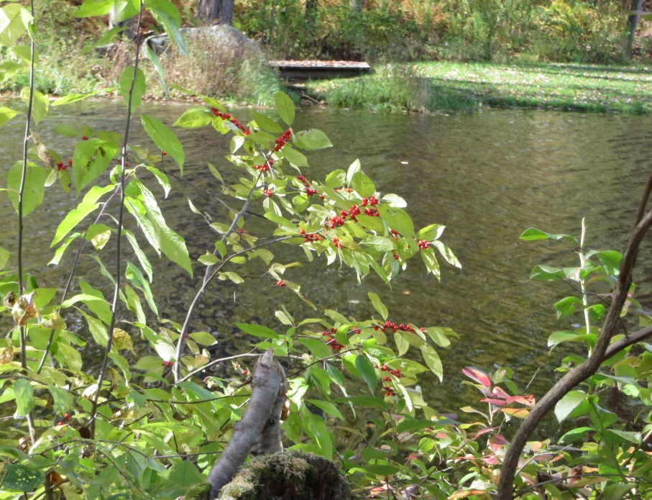
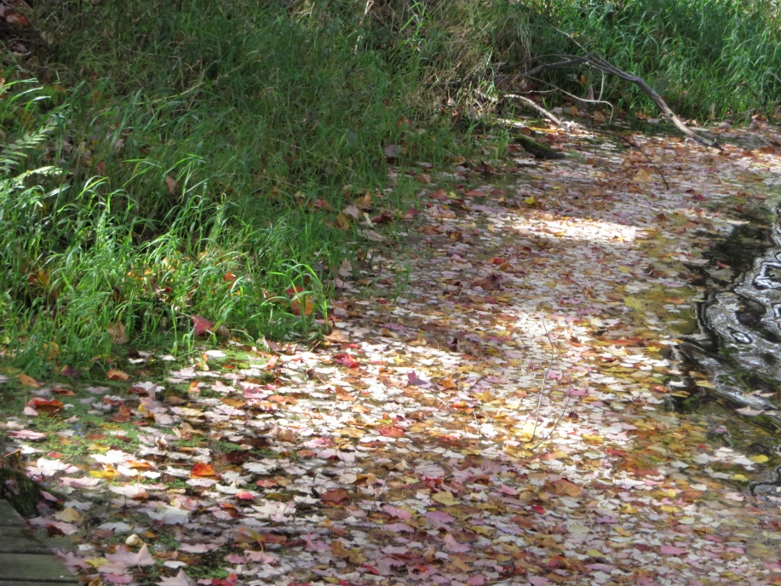
3. Bridges

Slide 16
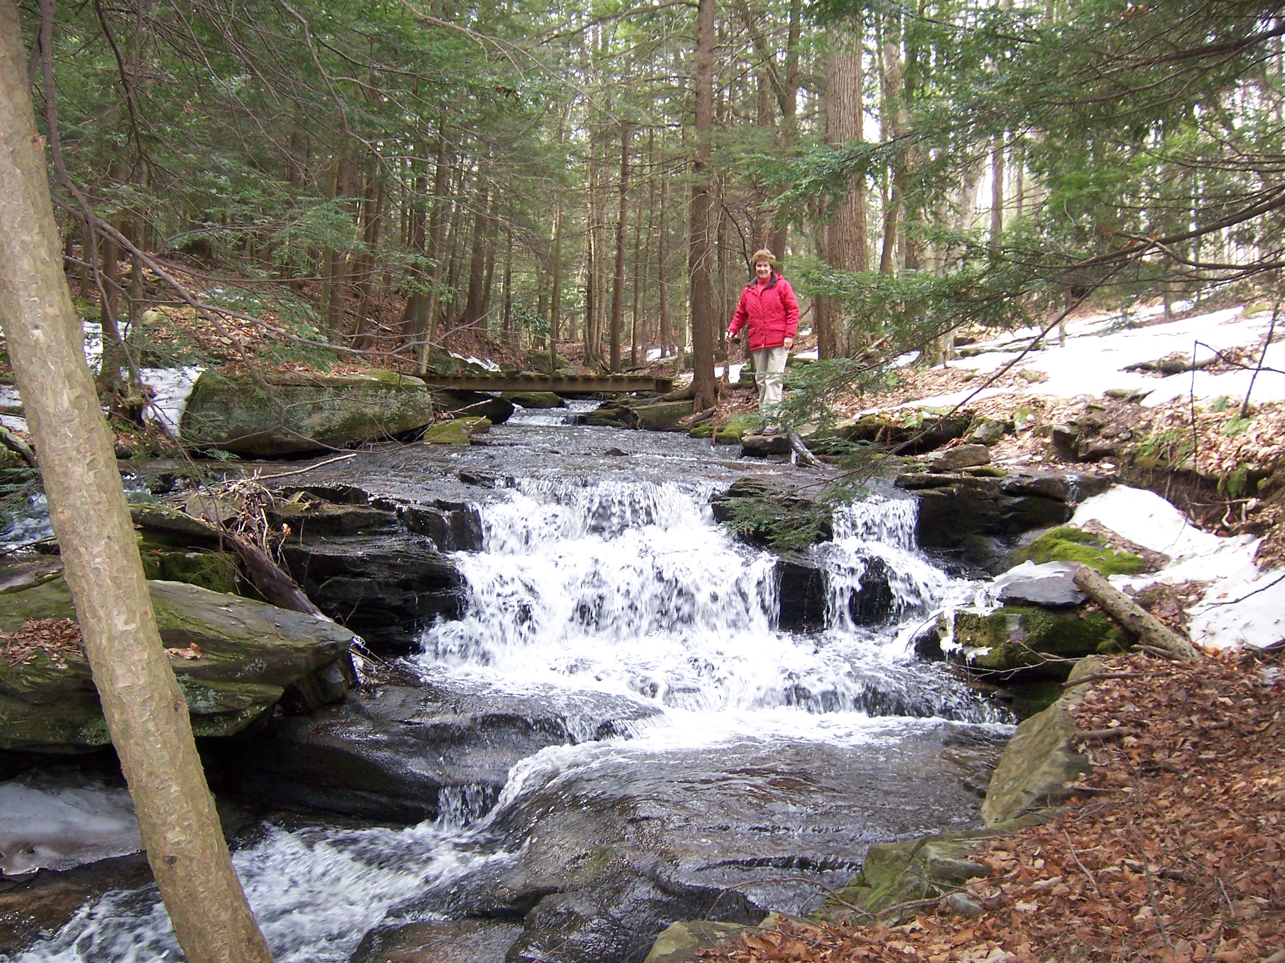
4. Stream and Foot Bridge

Slide 17
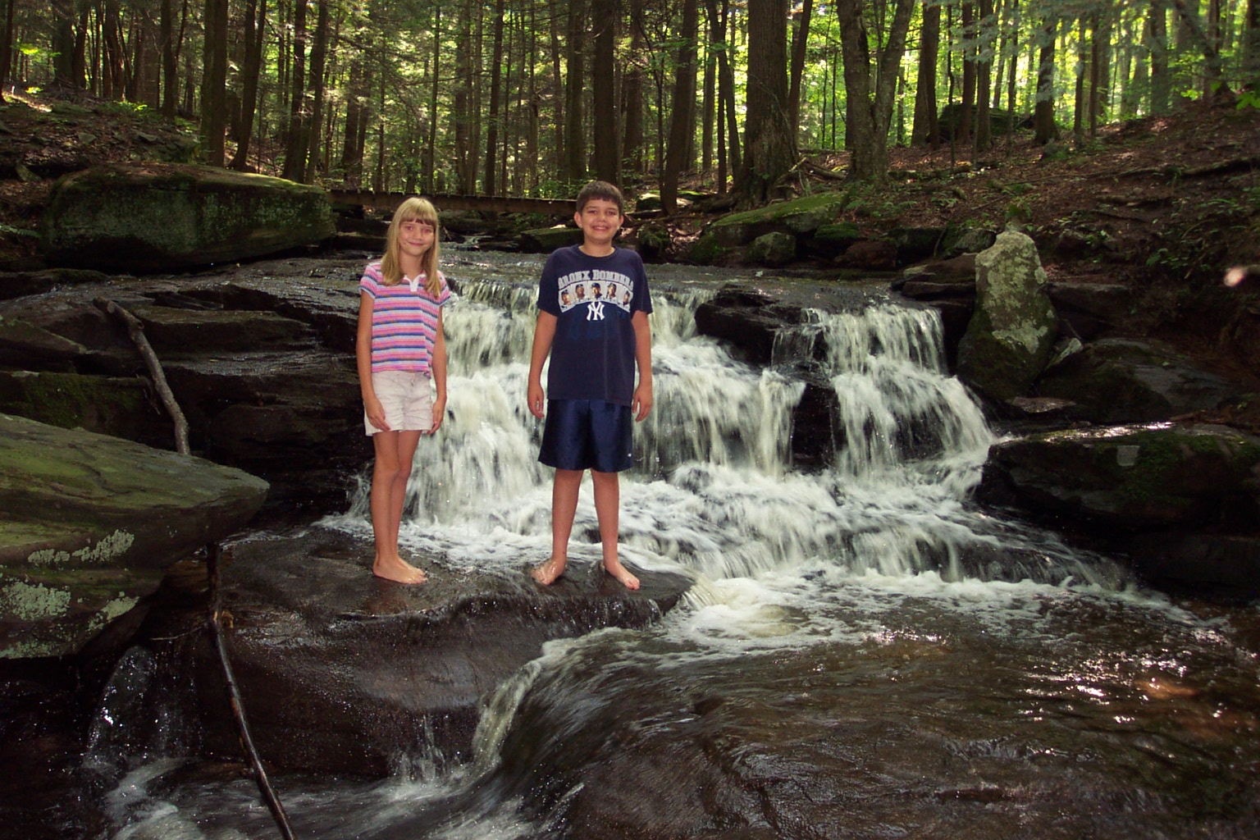
5. Waterfall

Slide 18
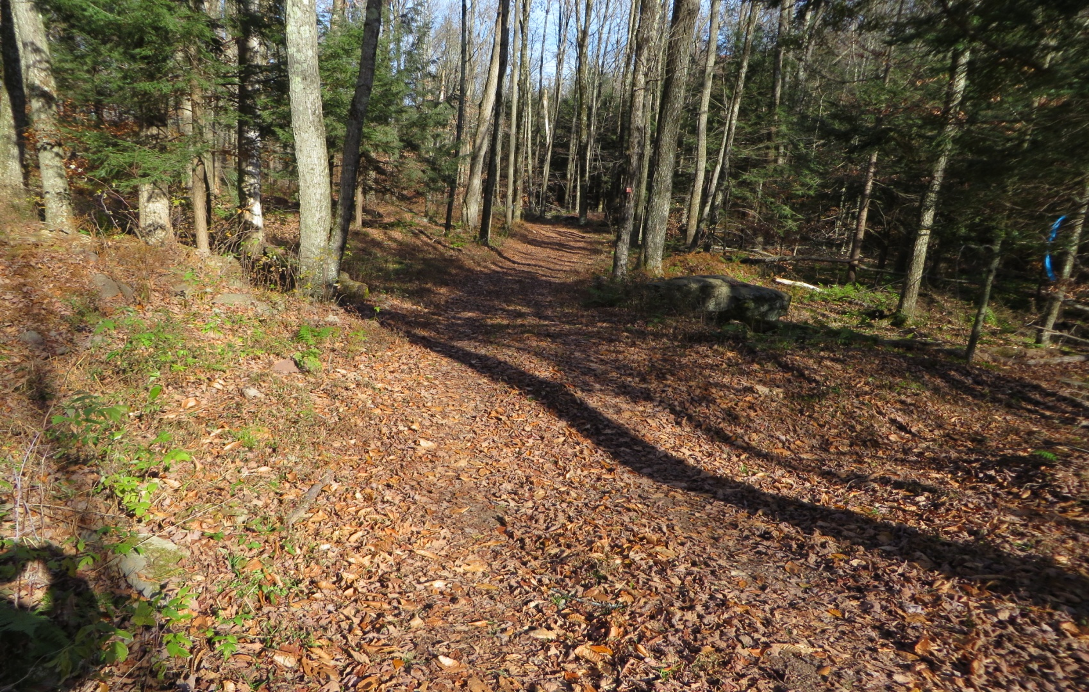
6. Water Bar
A diagonal channel across a trail/road on a hillside to divert water from trail/road and decrease erosion.
Water bar on trail to waterfall

Slide 19

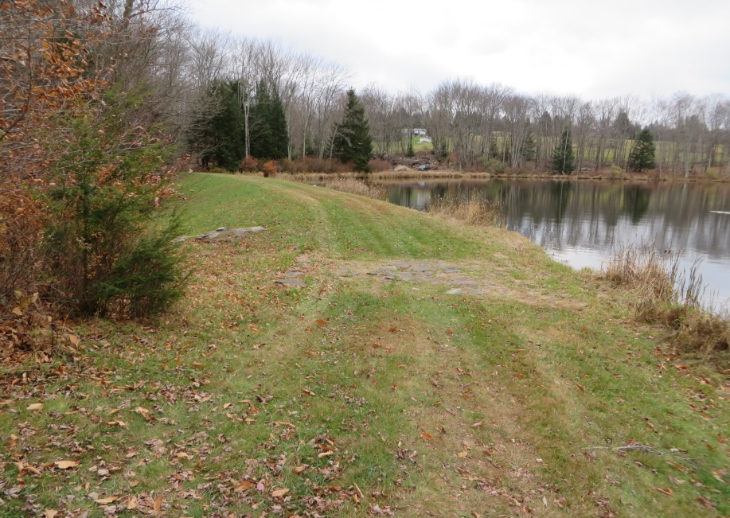
7. Spillways
An area of 6’ to 8’ wide of the lake dam and pond dam that is a foot or so lower than the grass top of the dam.
It is designed to protect the dam especially during intense storms by letting water to flow over the rock-lined spillway instead of over the grass – topped dam.
Pond Spillway Lake Spillway

Slide 20
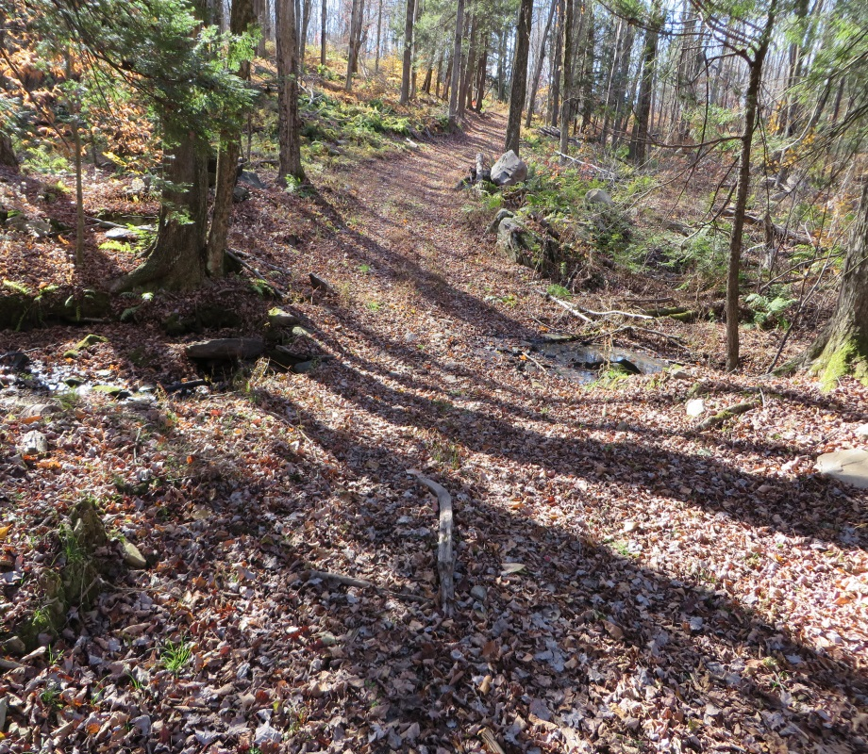
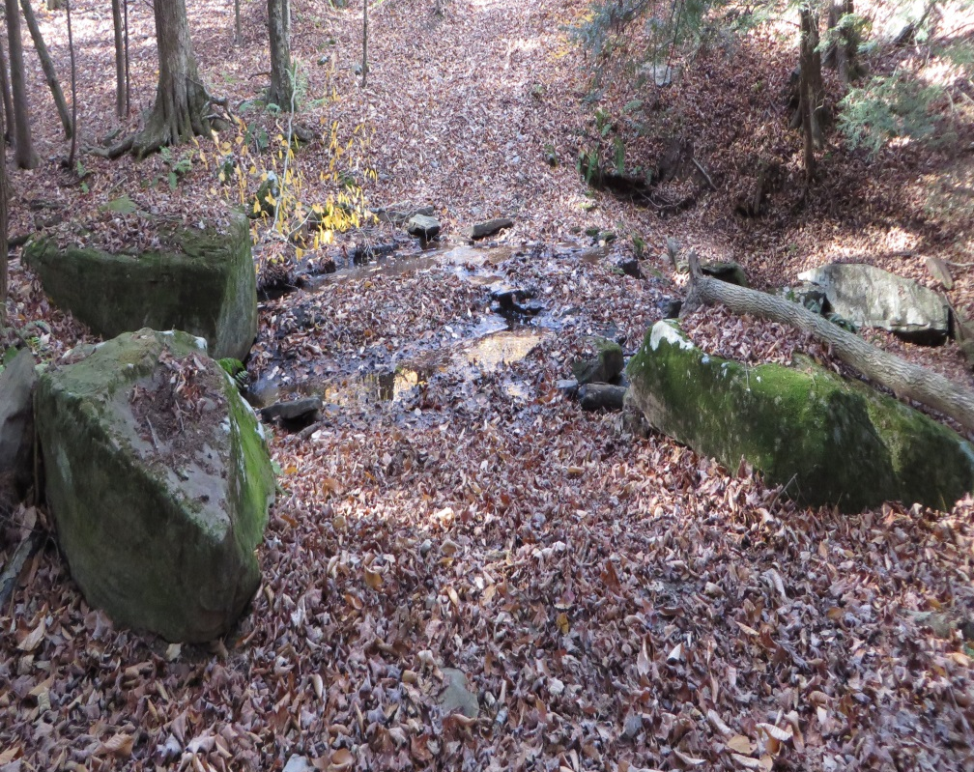
8. Fords
Area for stream crossing through water in a shallow stream bed.
Commonly used by pioneers in camp area.
Below Lake dam Above waterfall
Ford
Ford
Ford

Slide 21
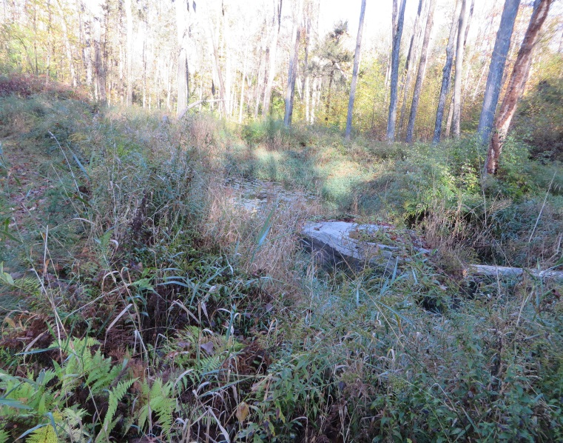
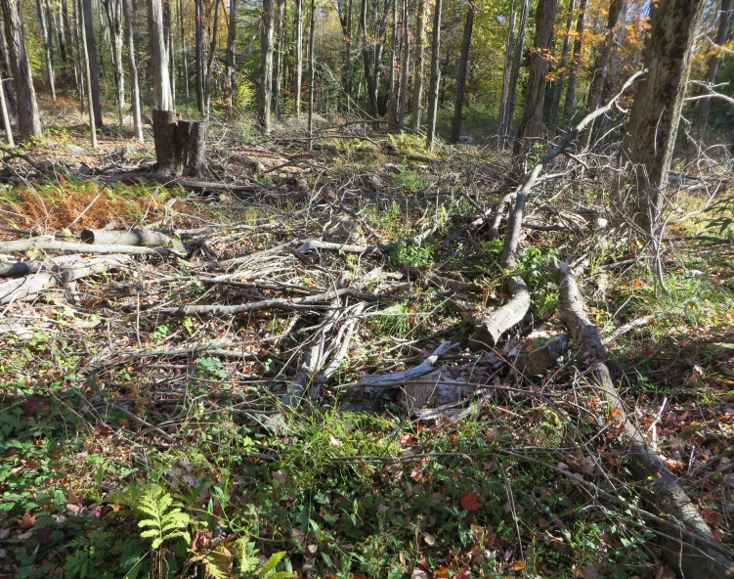
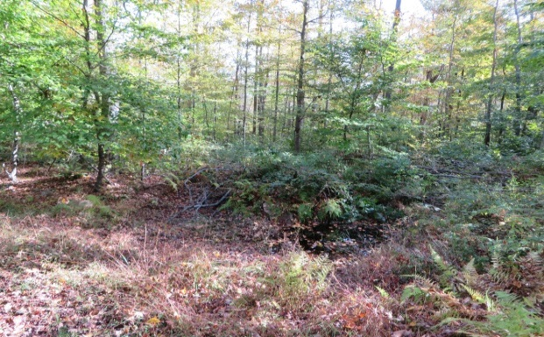
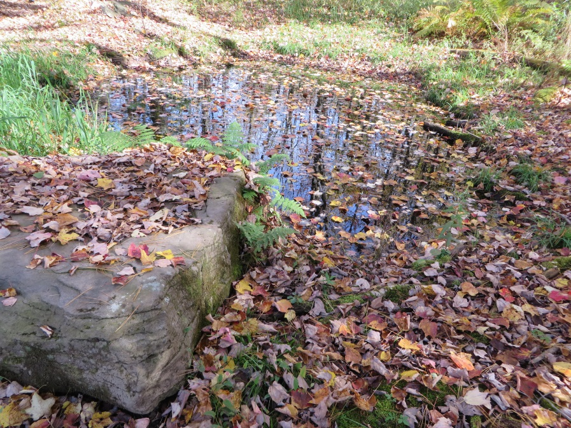
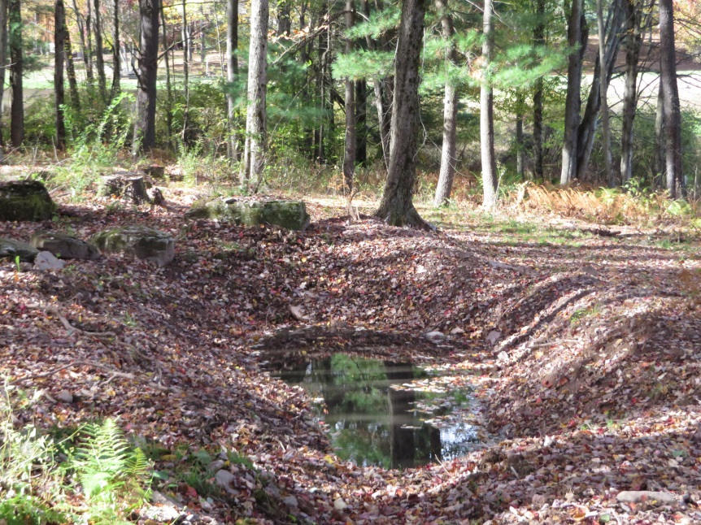
9. Five
Vernal Ponds
Ponds that typically dry up in the summer.
Great for amphibians e.g. frogs, and reptiles due to too little water in summer for fish (their major predator) to survive.
Wetland Pond
Peter’s Pond
Trail Pond
Frog Pond
Arboretum Pond

Slide 22
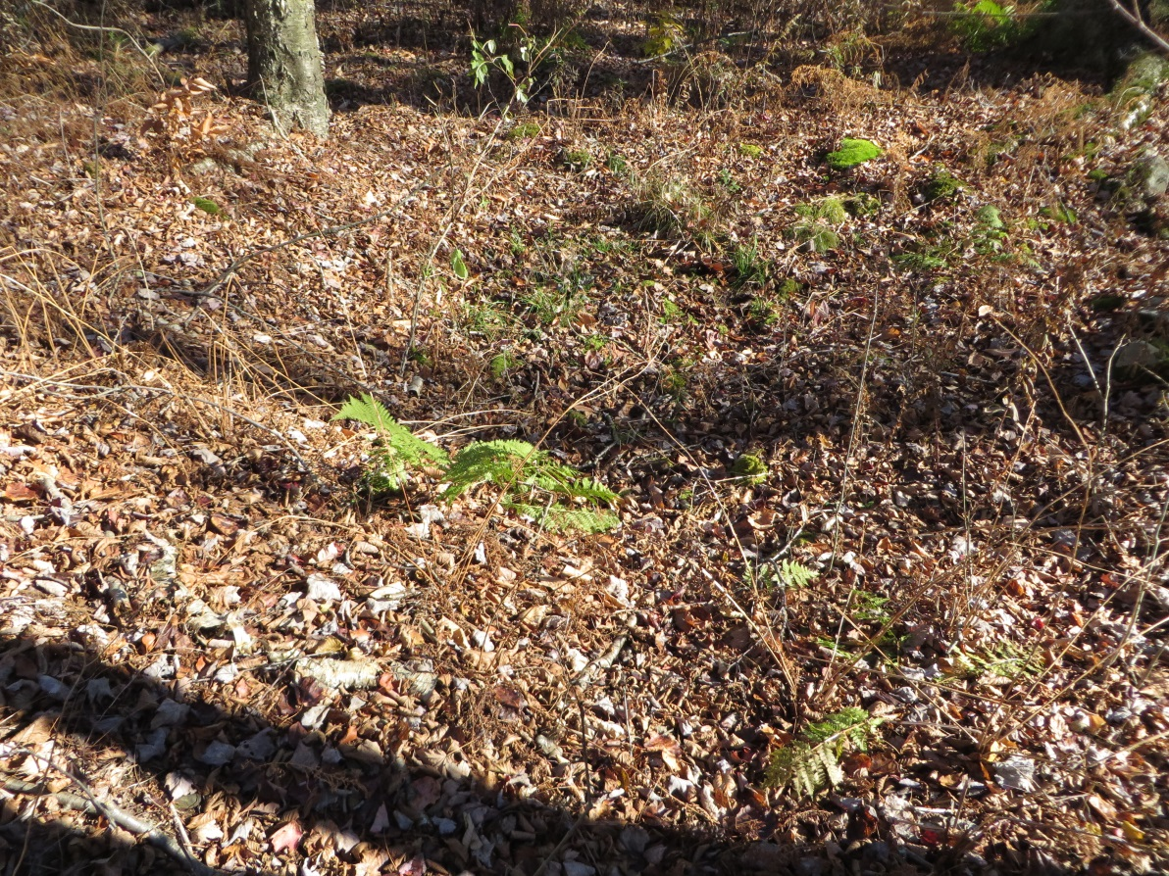
10. Springs
Water flows to the surface of the earth from the underground.
Spring

Slide 23
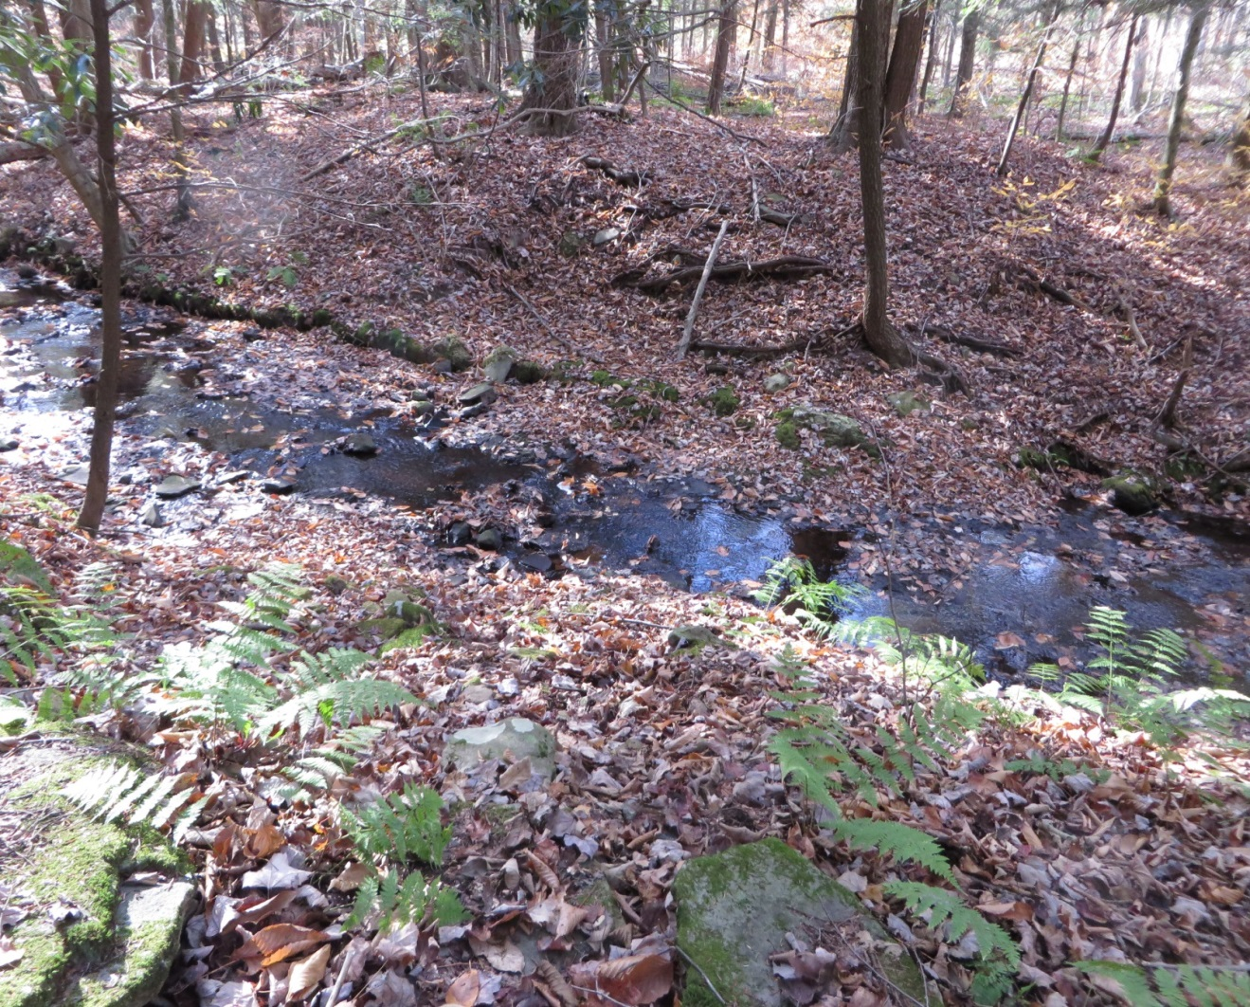
11. High Bridge
Used in the mid to late 19th Century
No remains
Bridge site

Slide 24
12. General Water Flow
Stream water flow – wetland near basketball court upper pond stream pond stream lake stream waterfall stream South Calkins Creek Delaware River Delaware Bay at Philadelphia Atlantic Ocean

Slide 25
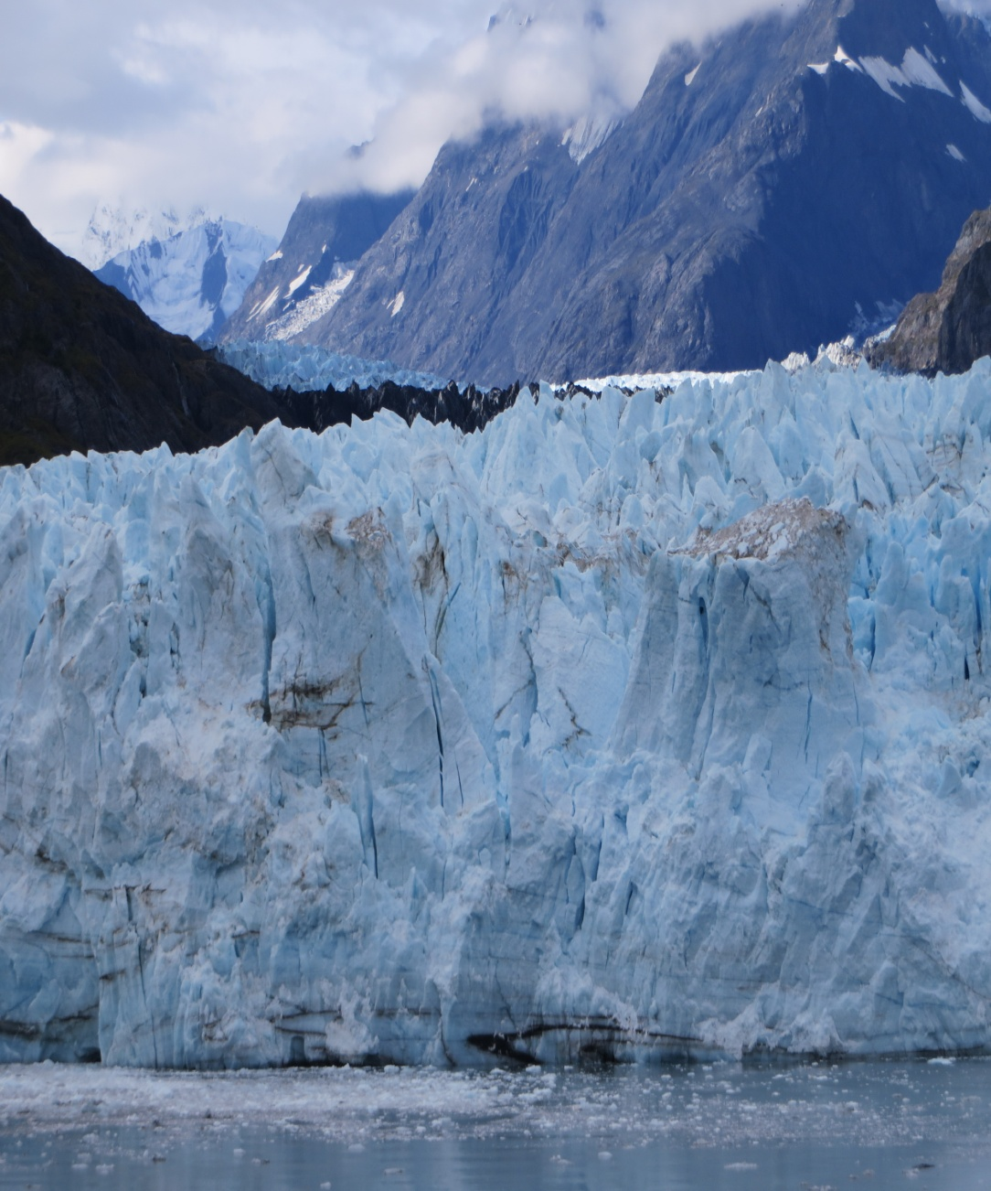
E. Land:
Glaciers
During the Ice Age 15,000 years ago glaciers from upper Canada covered the camp and all mountain tops and valleys in North East Pennsylvania
The slowly moving ice, over 1000 feet thick deep, ground rocks and boulders – everything in its way
Shaped the mountains, valleys, and swamps
Modern glacier in Alaska moving down valley between mountains to the ocean

Slide 26
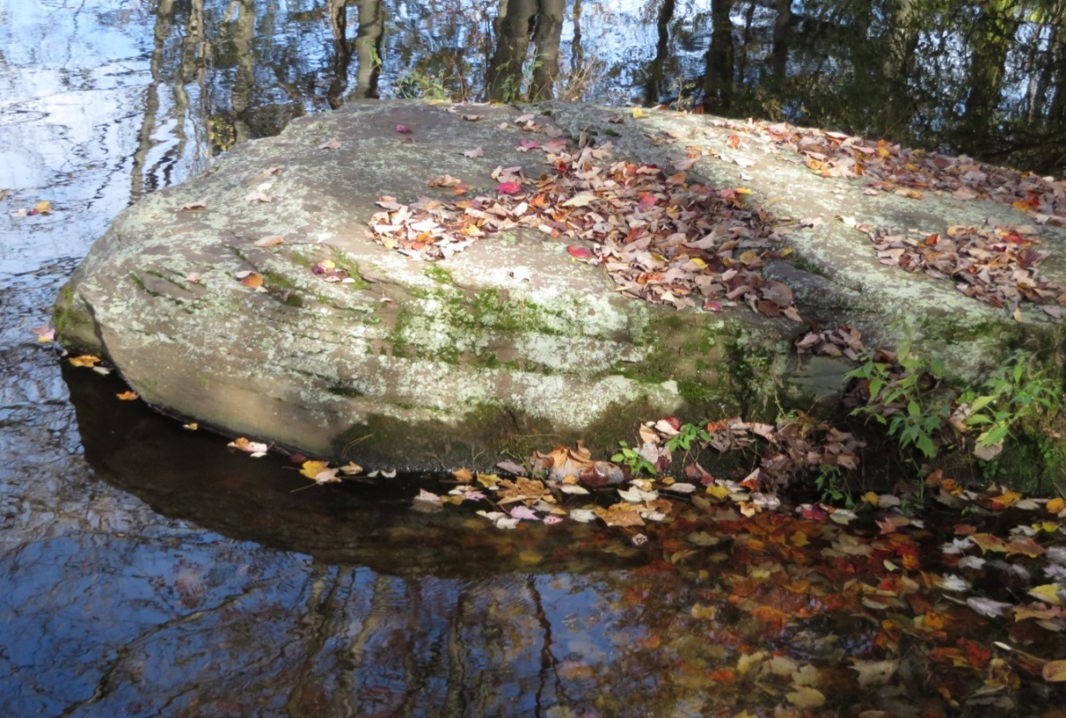
Rocks: Three General Types
1. Sedimentary Rock
Sandstone (from sand) and Shale (from mud) formed with great temperature and pressure.
Formed in Layers.
Most common rock type found in Pennsylvania

Slide 27
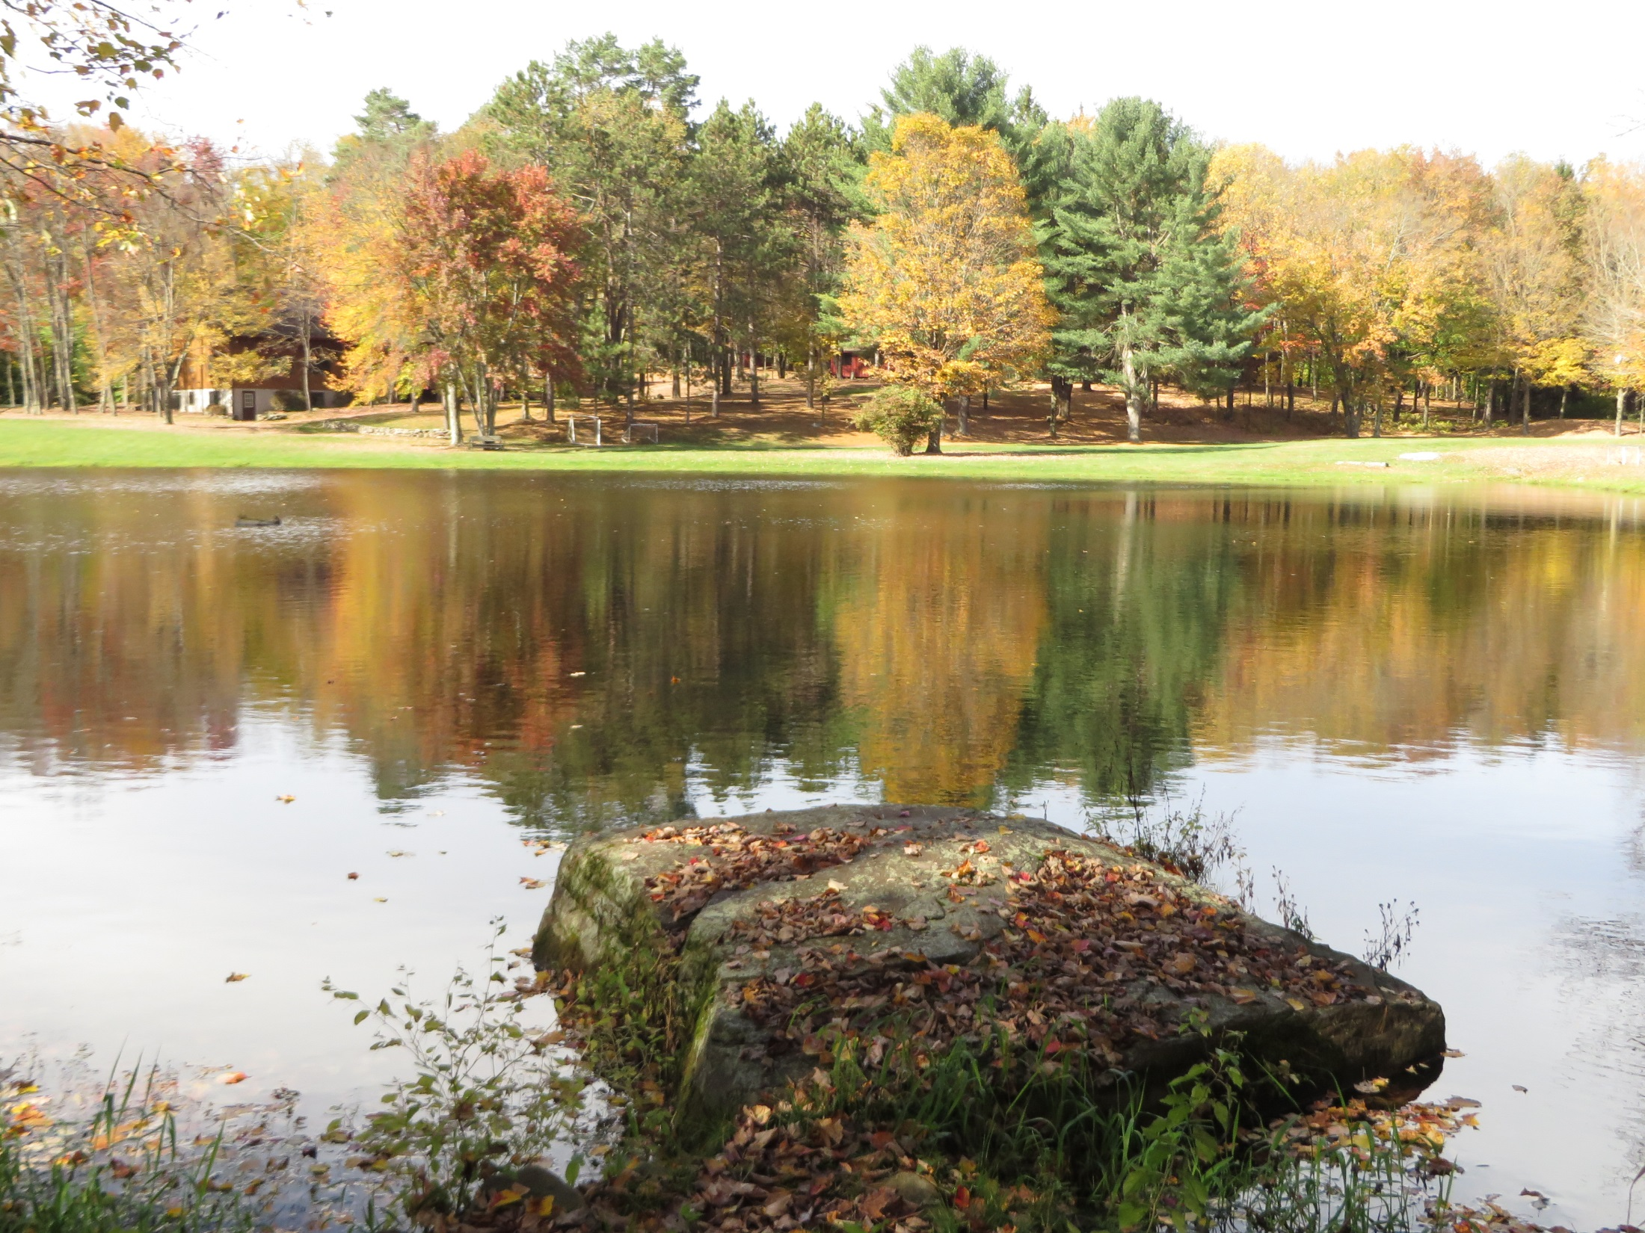

Slide 28
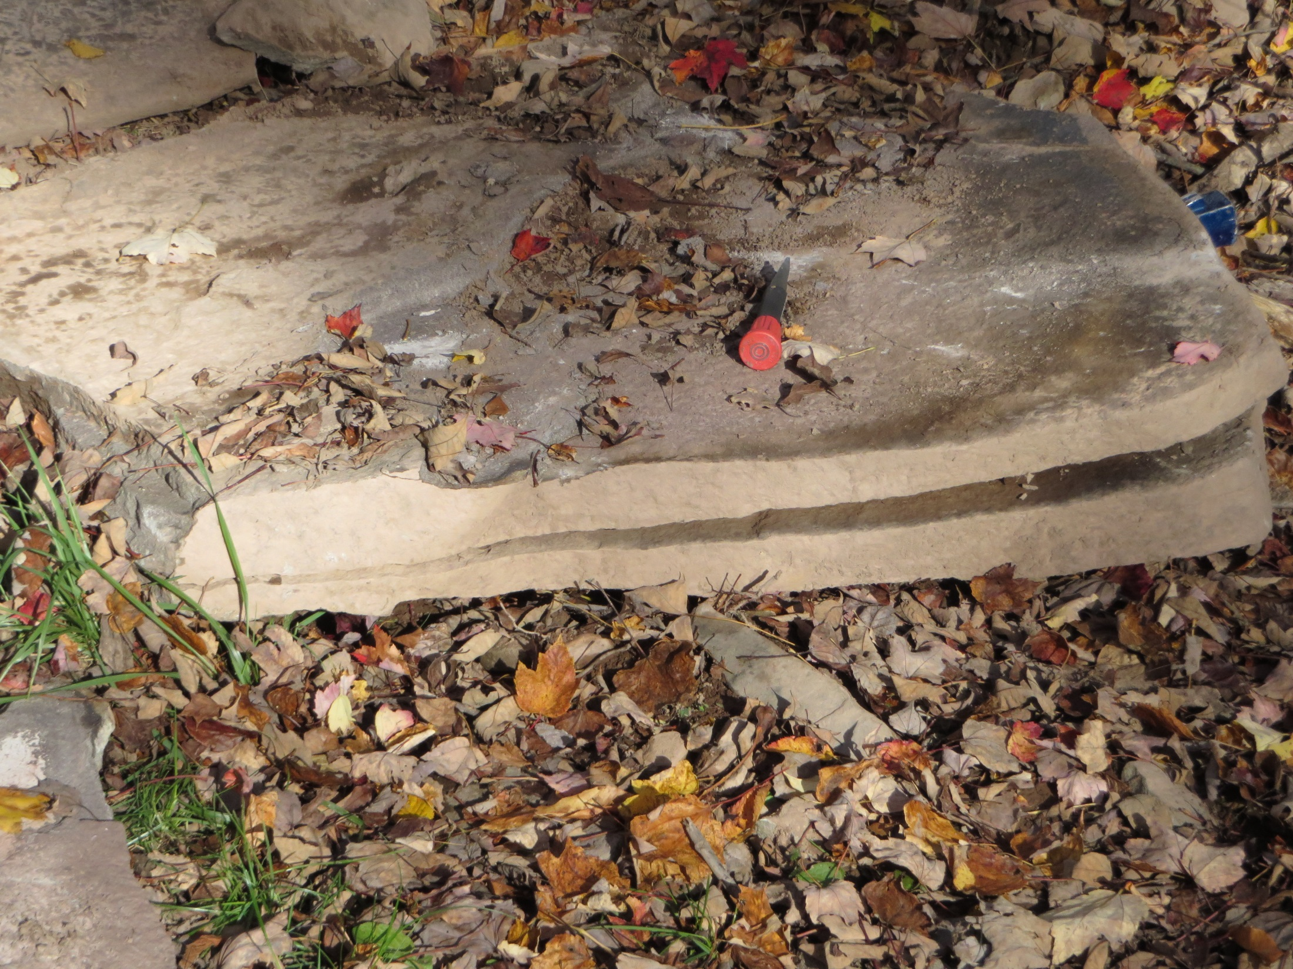

Slide 29
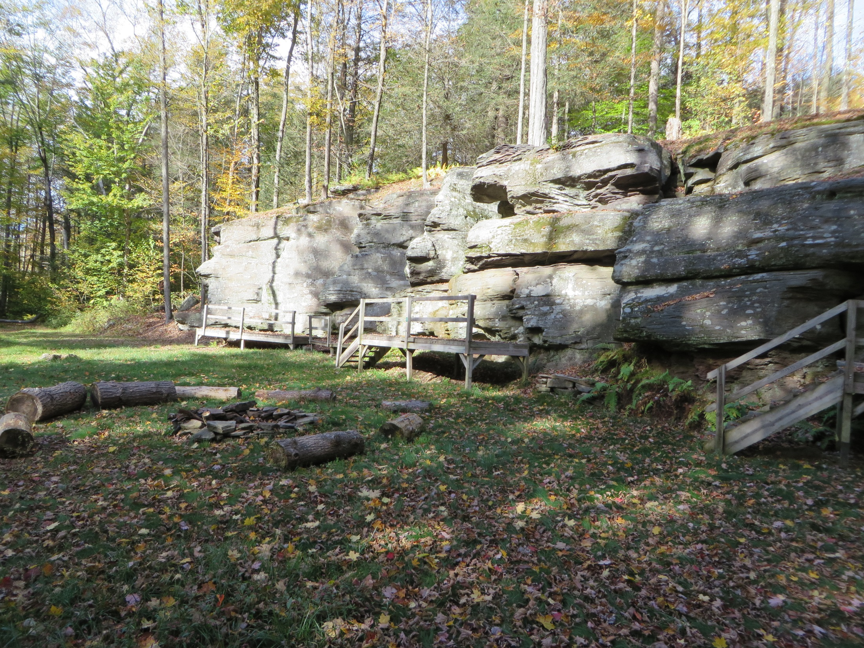

Slide 30
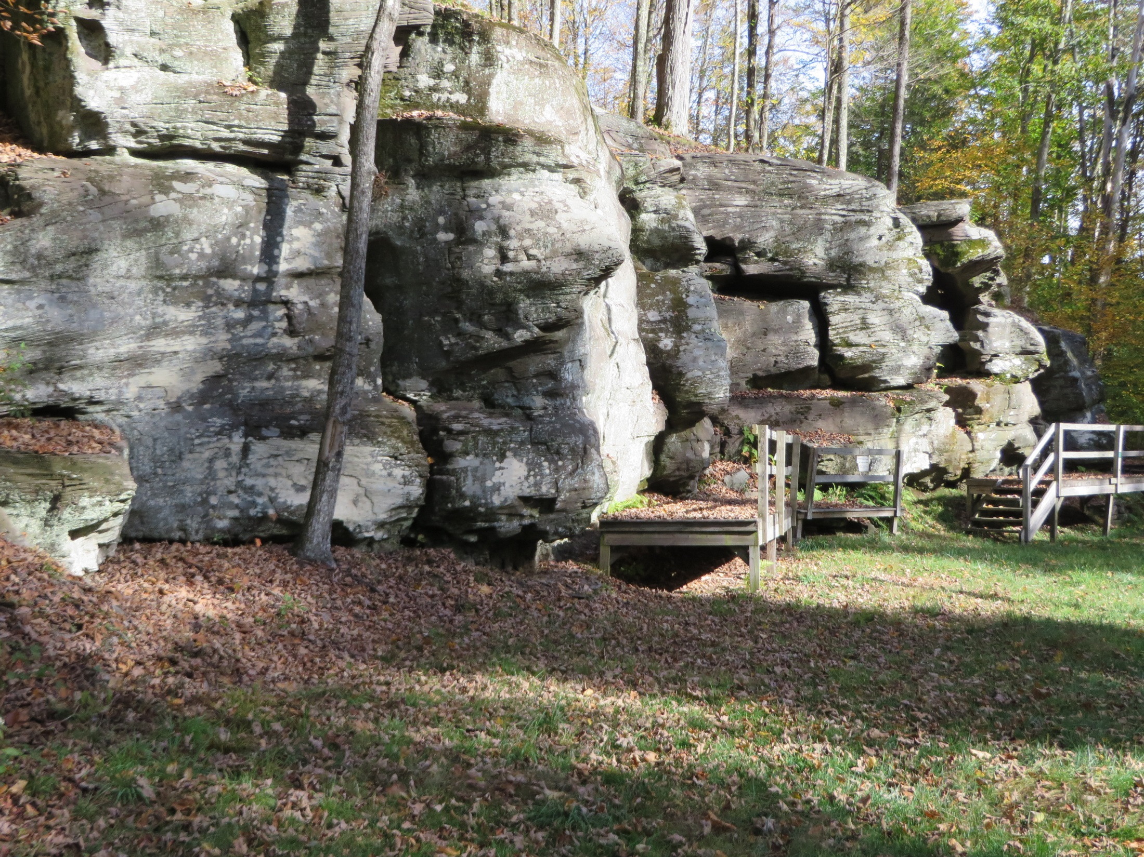

Slide 31
Pioneer Stone House 11’ x 13’
Built in 1850’s
Old Pioneer Stone House Built 1850’s
Walls being restored
Walls composed of Sedimentary Rock
Near High Bridge

Slide 32
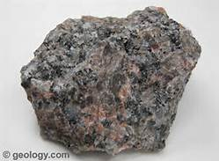
2. Igneous
From cooling molten Volcanic material either Lava (above ground) or Magma (below ground)
Found in southeast PA
E.g. granite

Slide 33
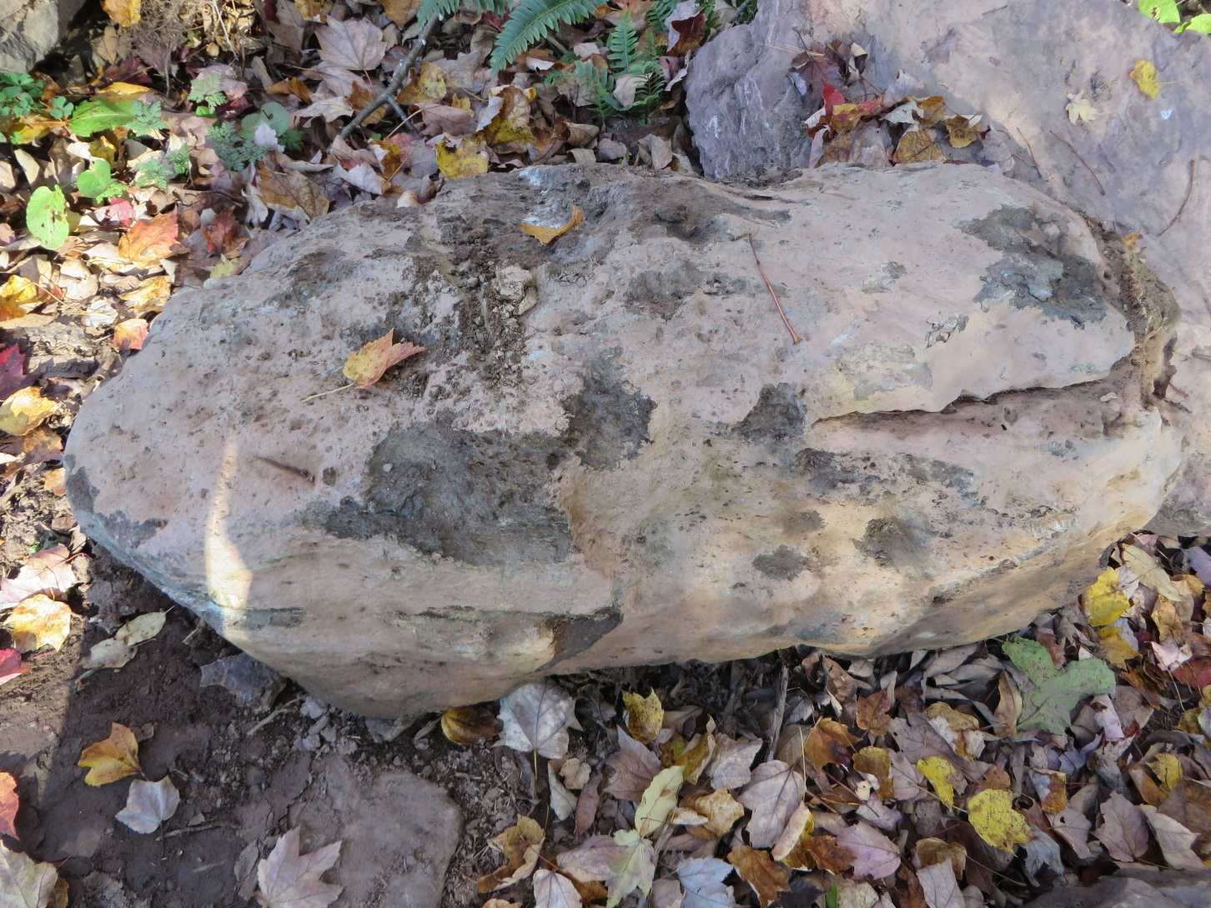
3. Metamorphic Rocks e.g. marble
Composed of sedimentary, igneous (volcanic) and older metaphoric rocks under great temperature and pressure.
Found in area of Arboretum

Slide 34
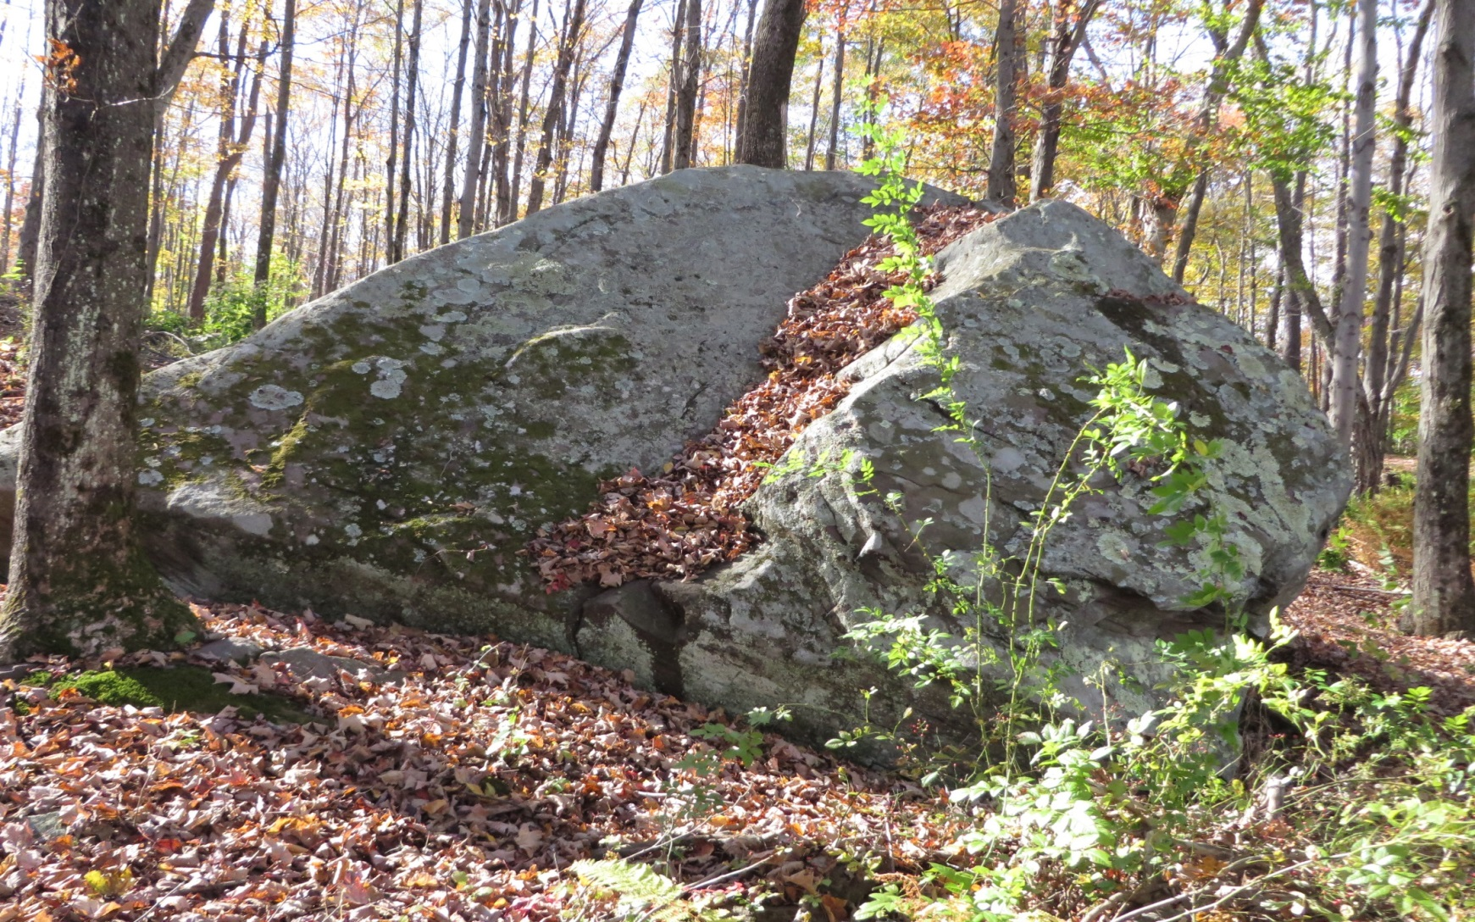
Mountain top Boulder
1485 feet above sea level

Slide 35
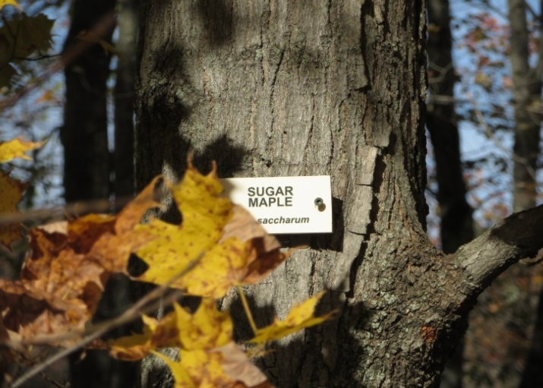
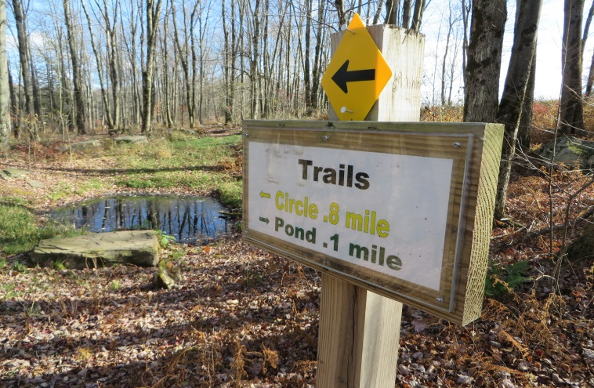
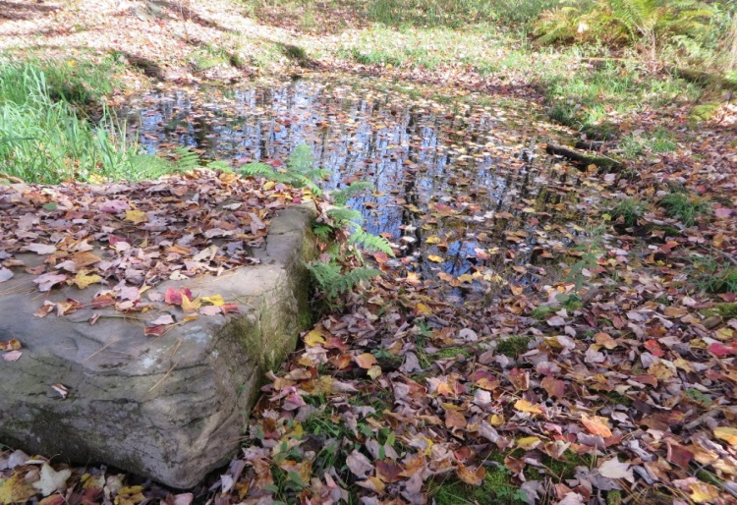

E. The Arboretum
Newly restored Nature and Archery/Program Area between the pond and lake shores and the stone wall.
Development Summer 2012-2013
Trails
Nature Signage
Benches
Labeled trees
Vernal ponds
Archery Area
Plantings of trees, bushes, and flowers

Slide 36
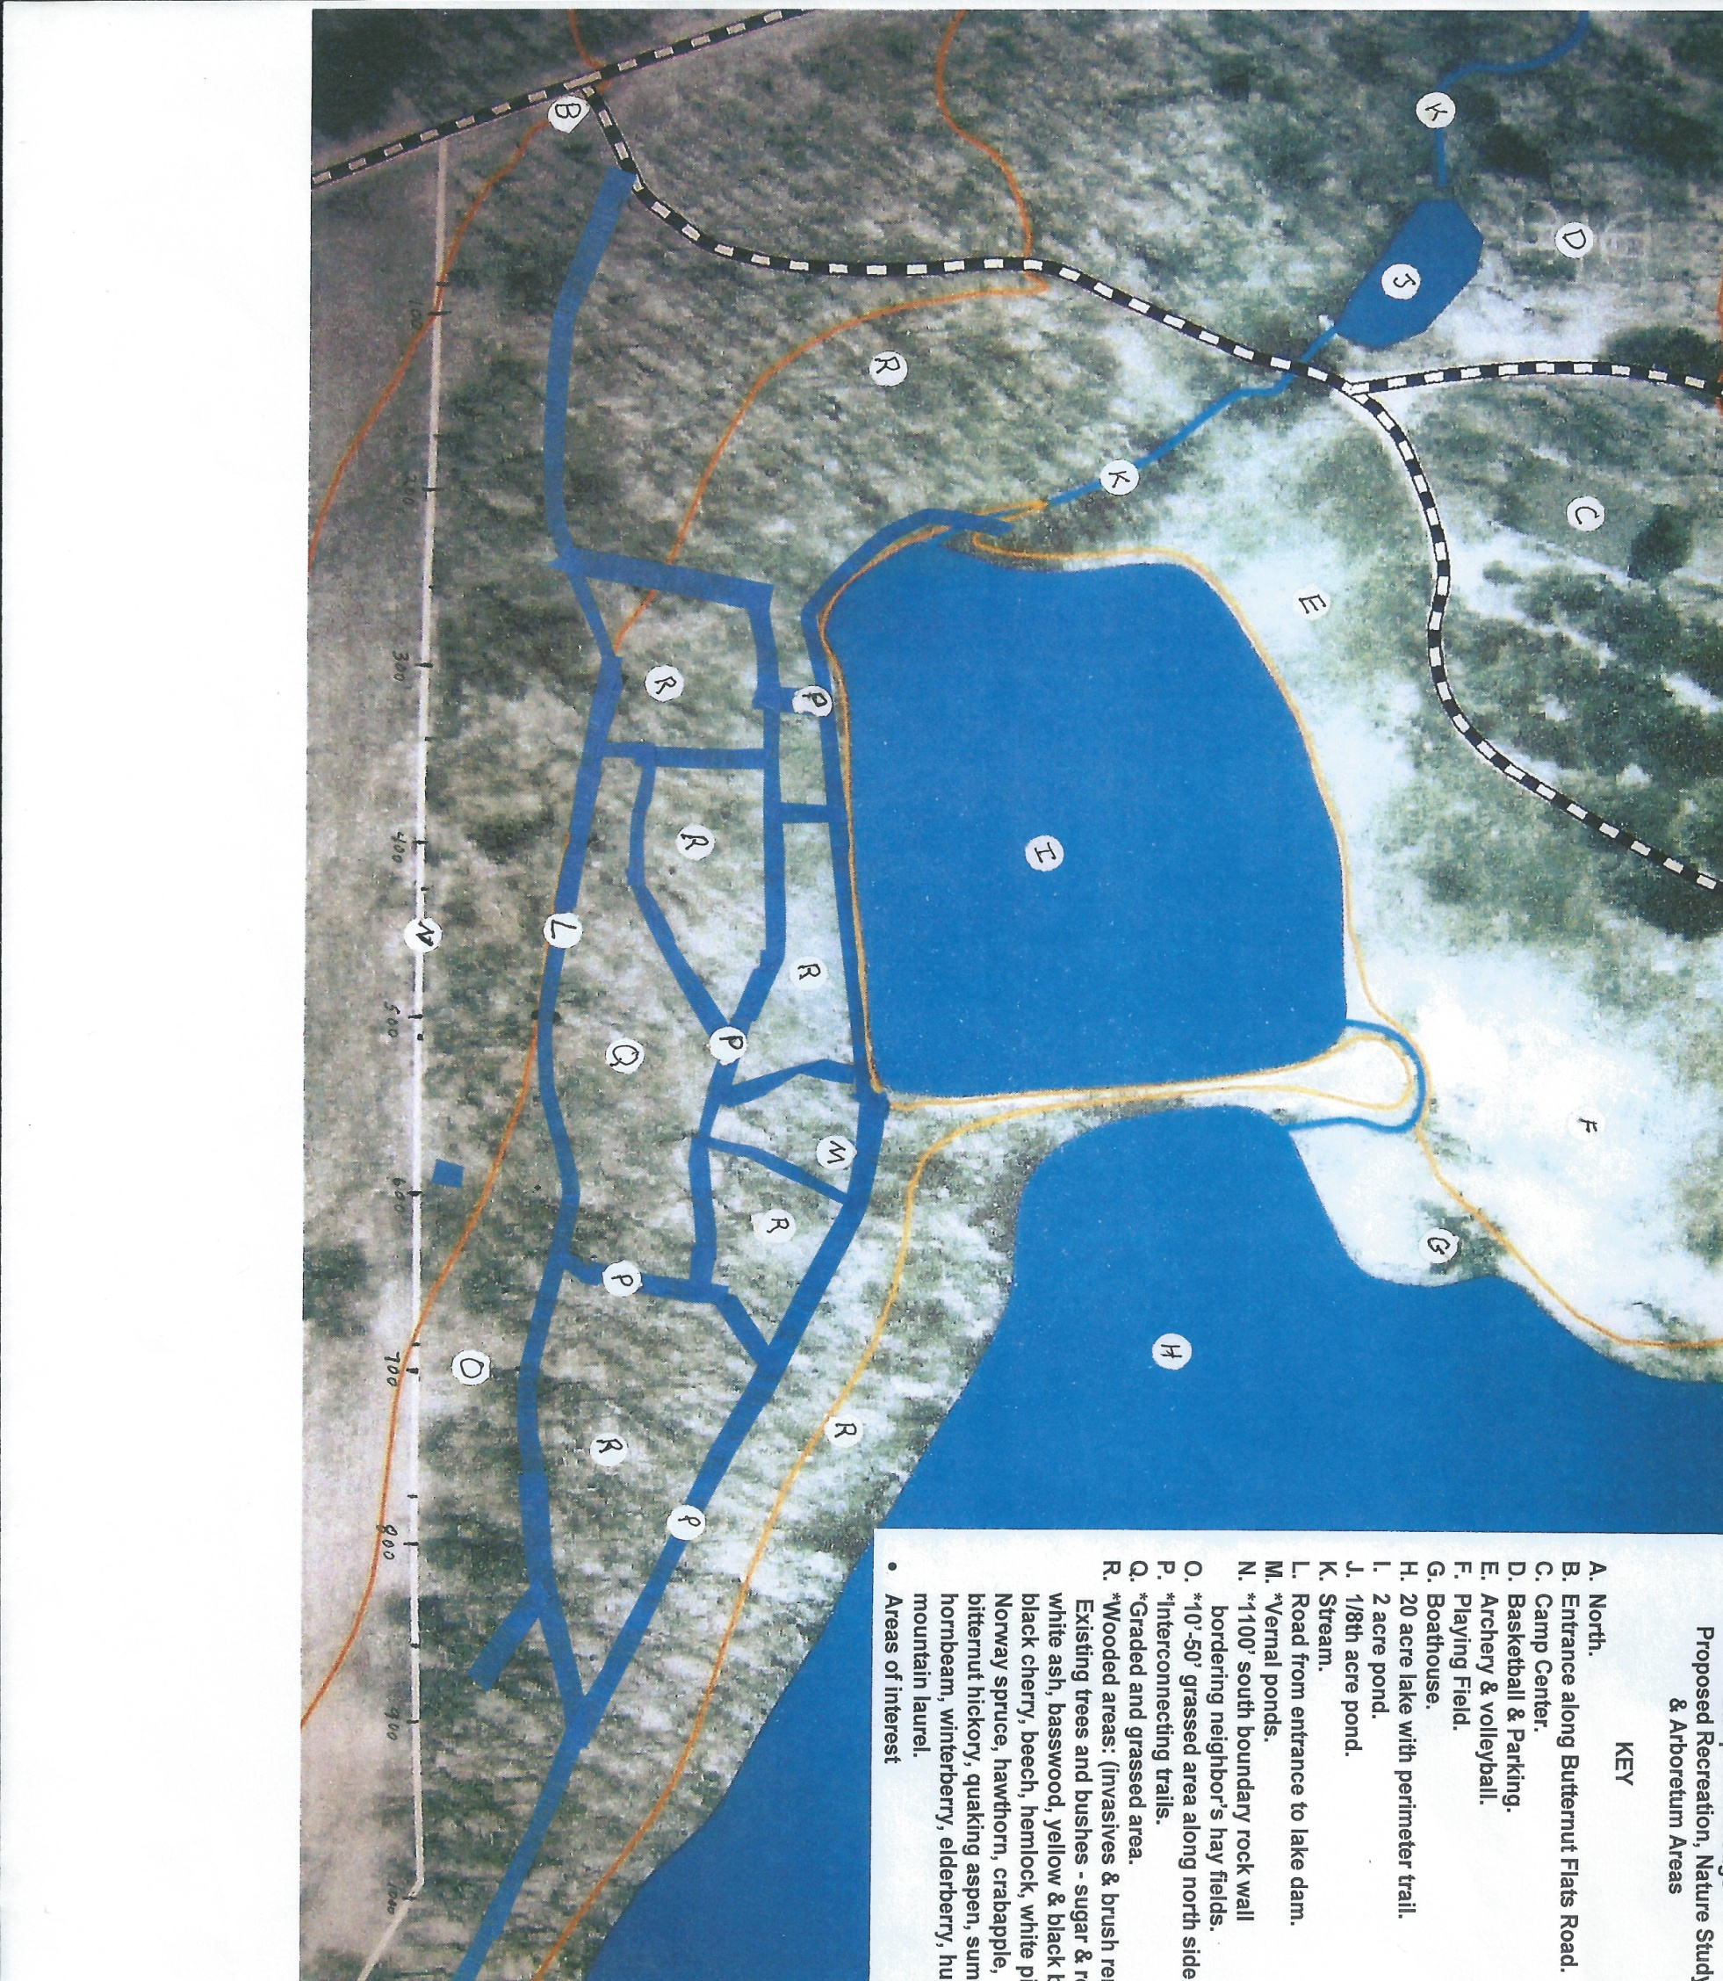

Slide 37
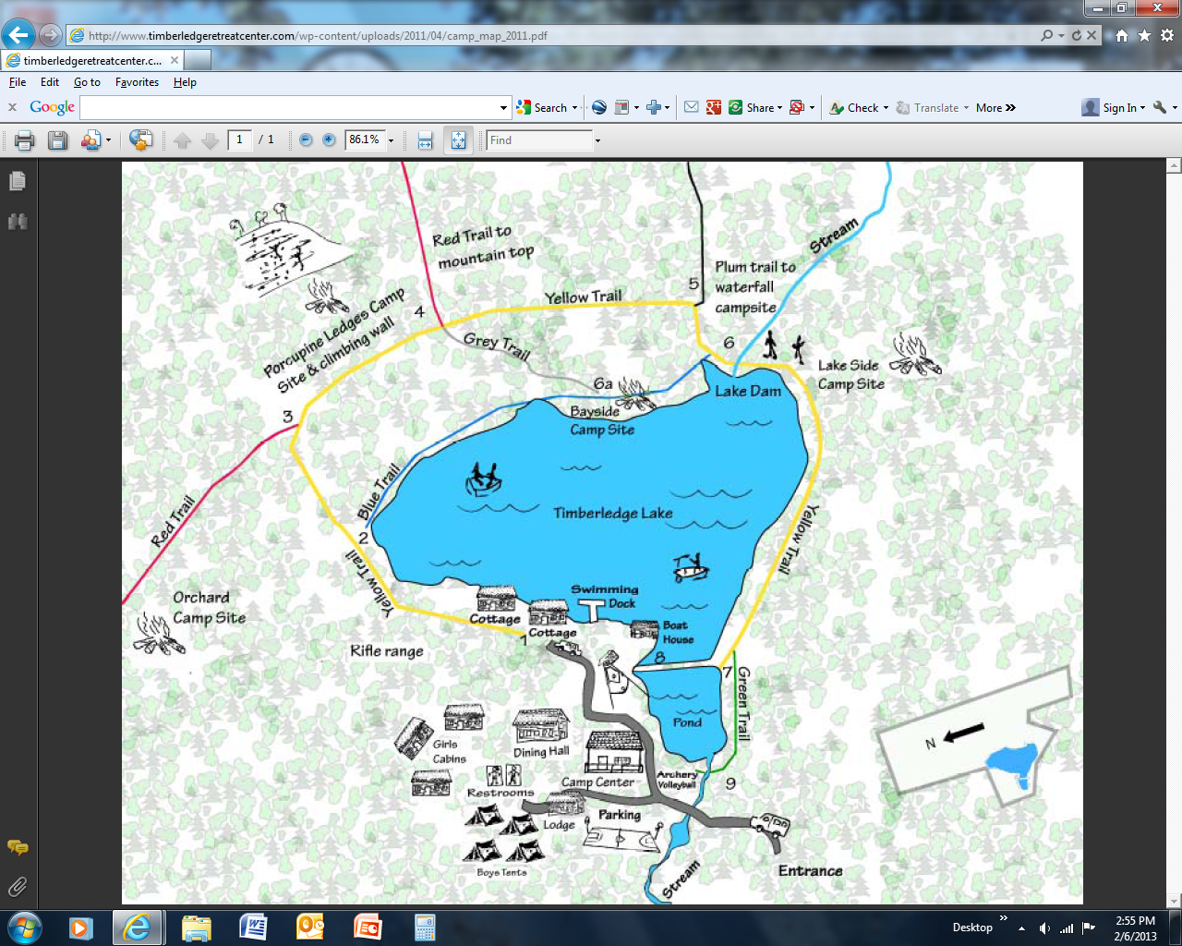
Basketball
Playing field
Camp Center
Lake
Pond
Arboretum
Archery
Wall
Google view from Satellite with trails added

Slide 38
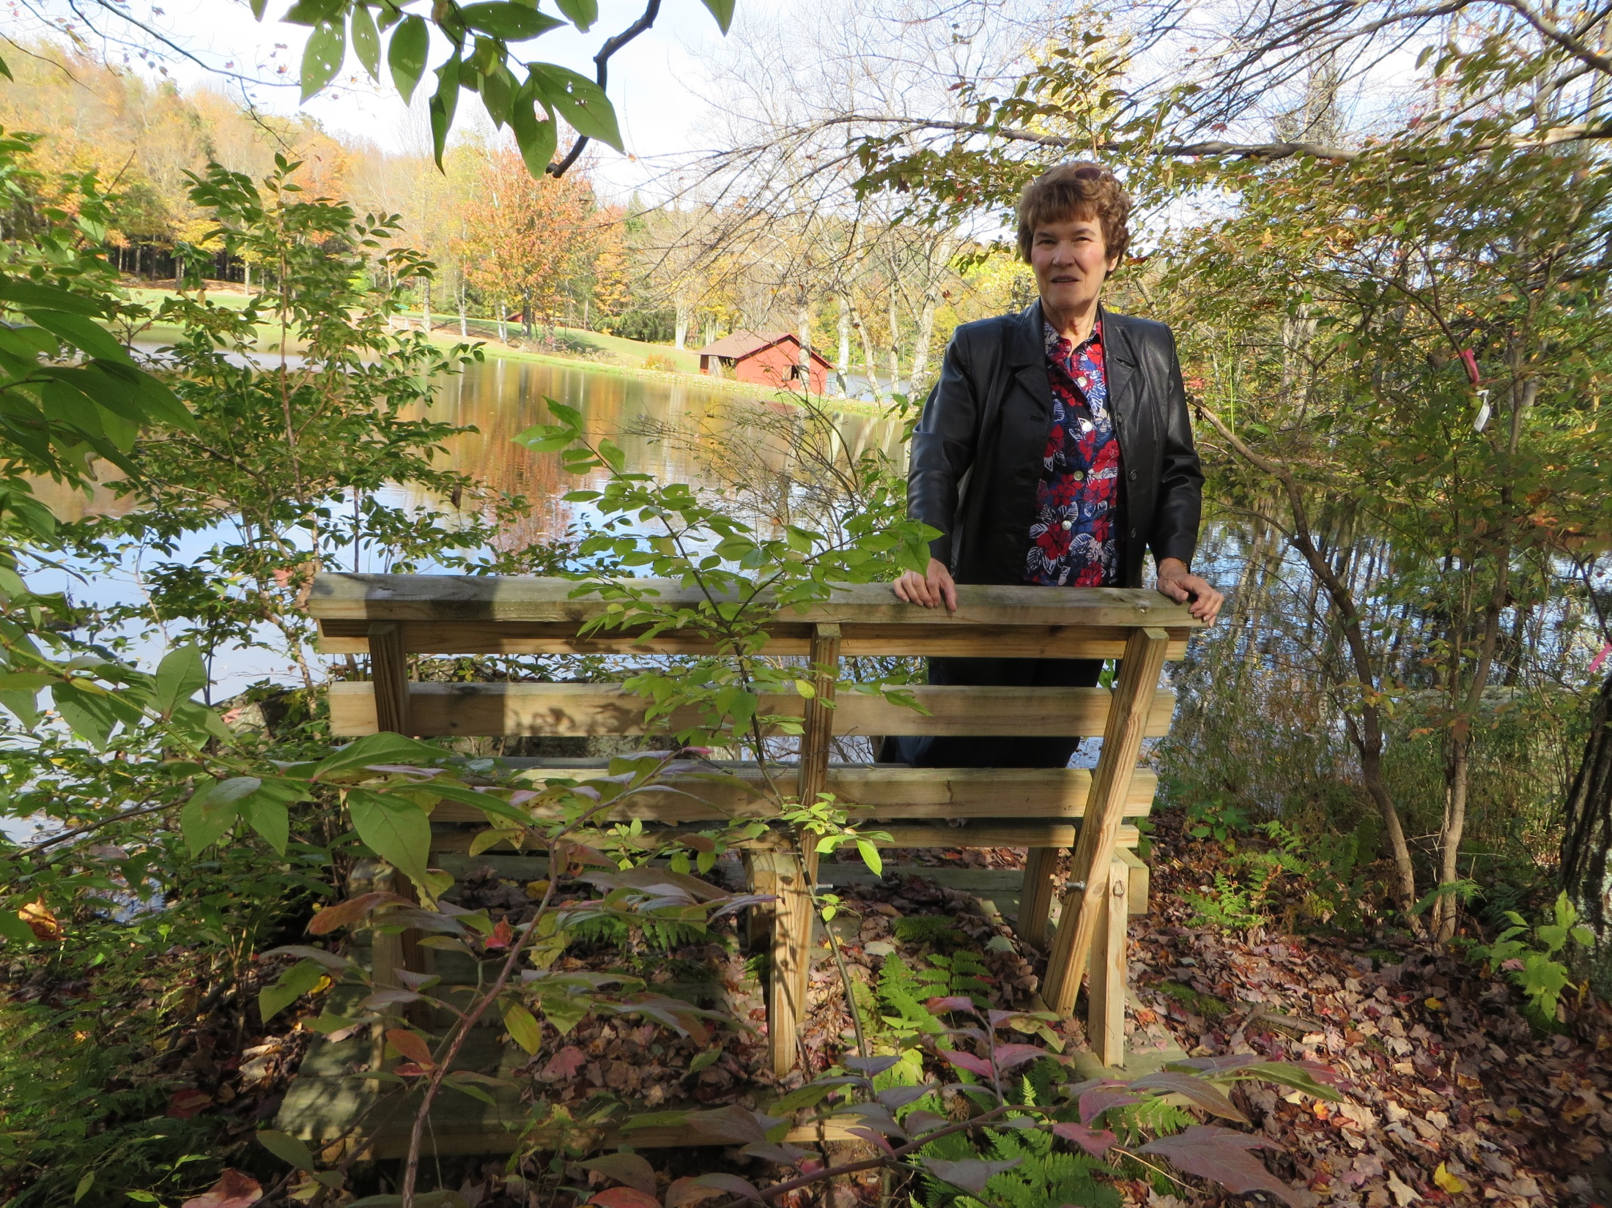

Slide 39
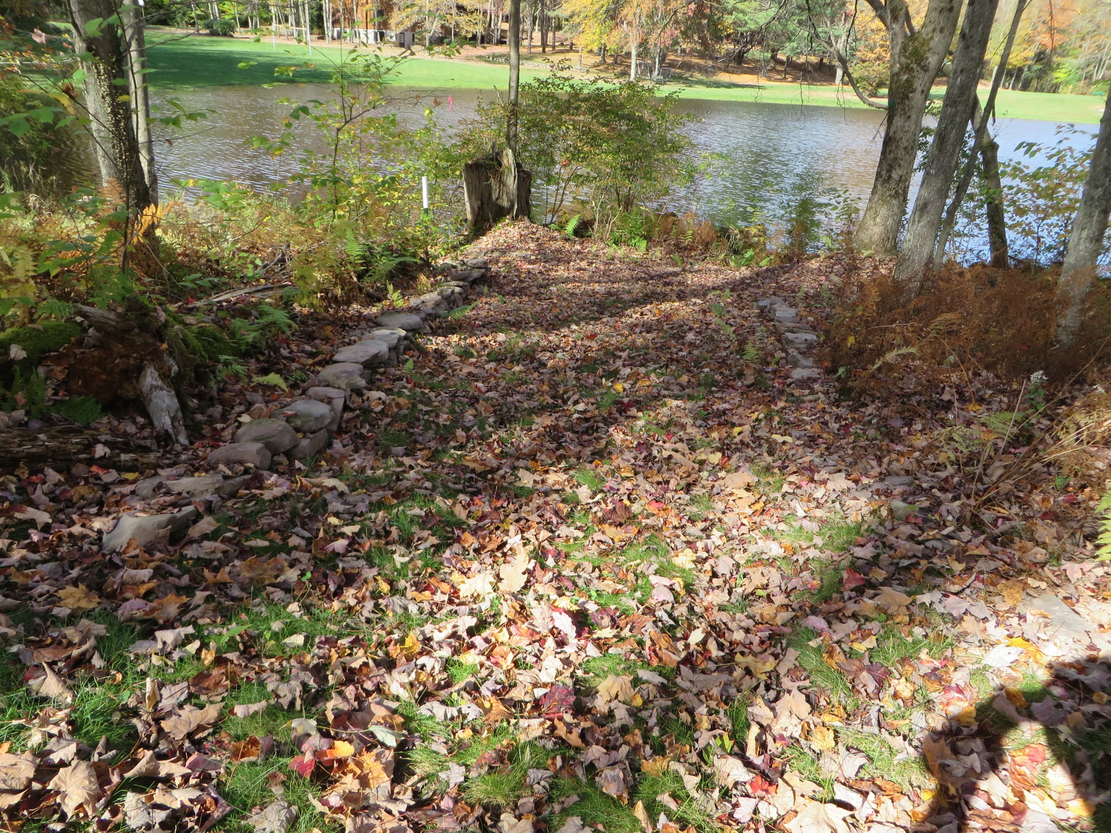

Slide 40
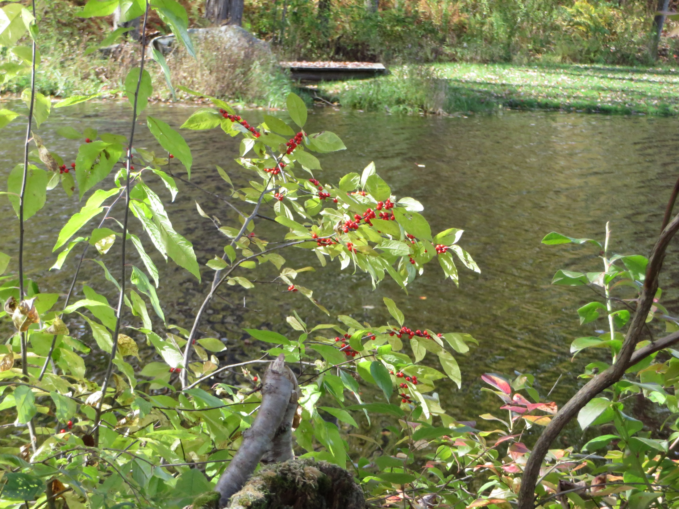

Slide 41
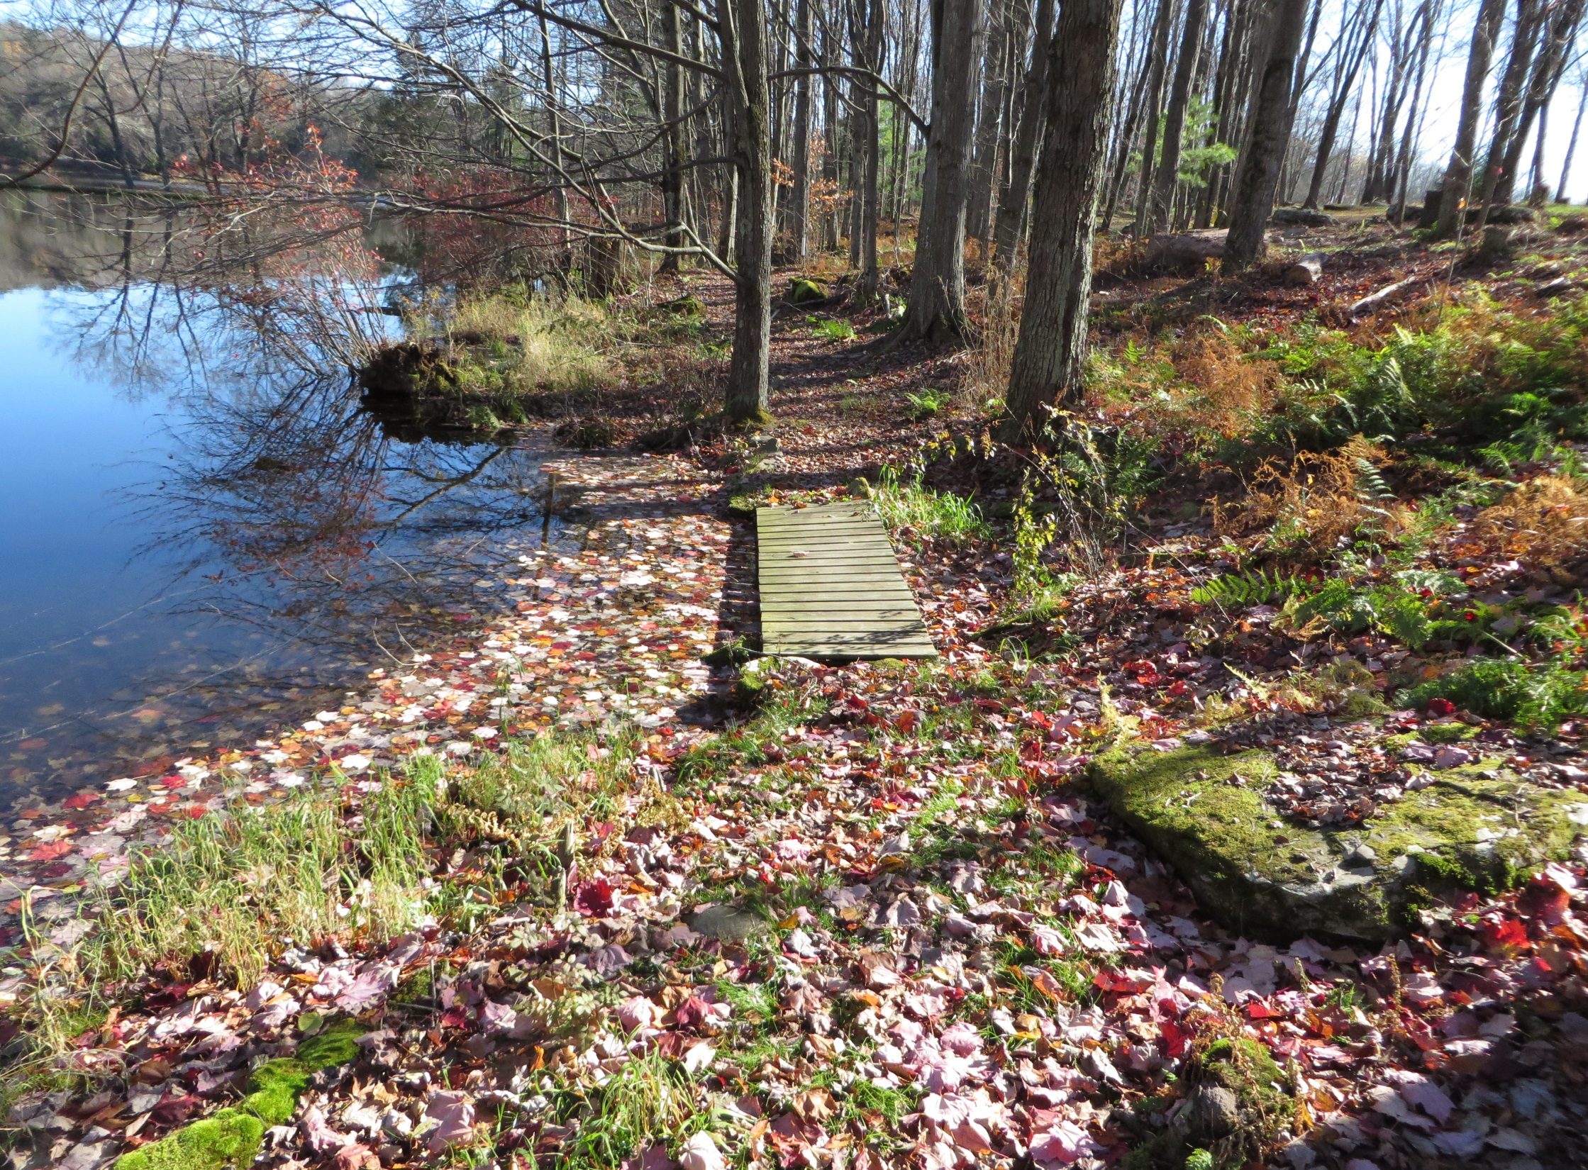

Slide 42
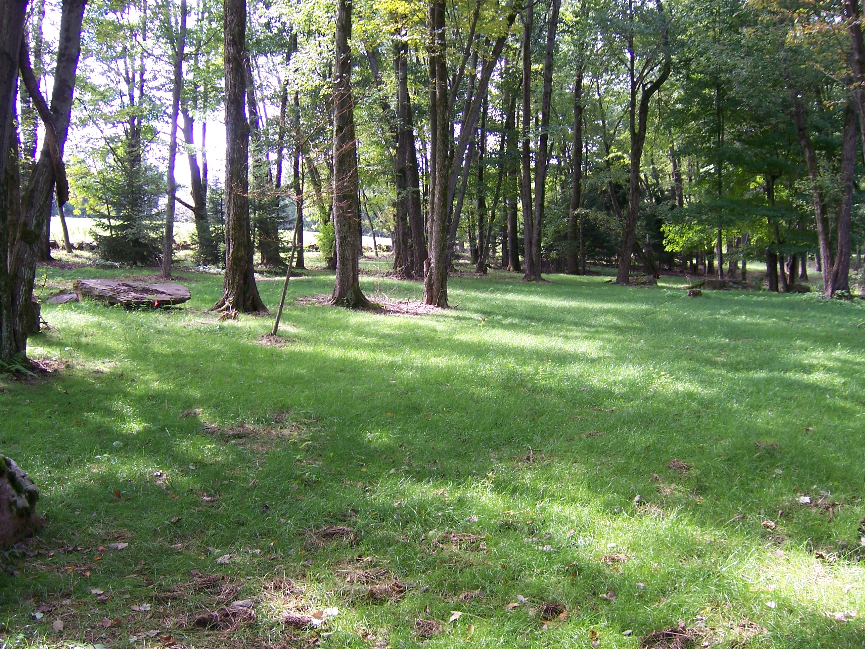
New Archery and Program Area

Slide 43
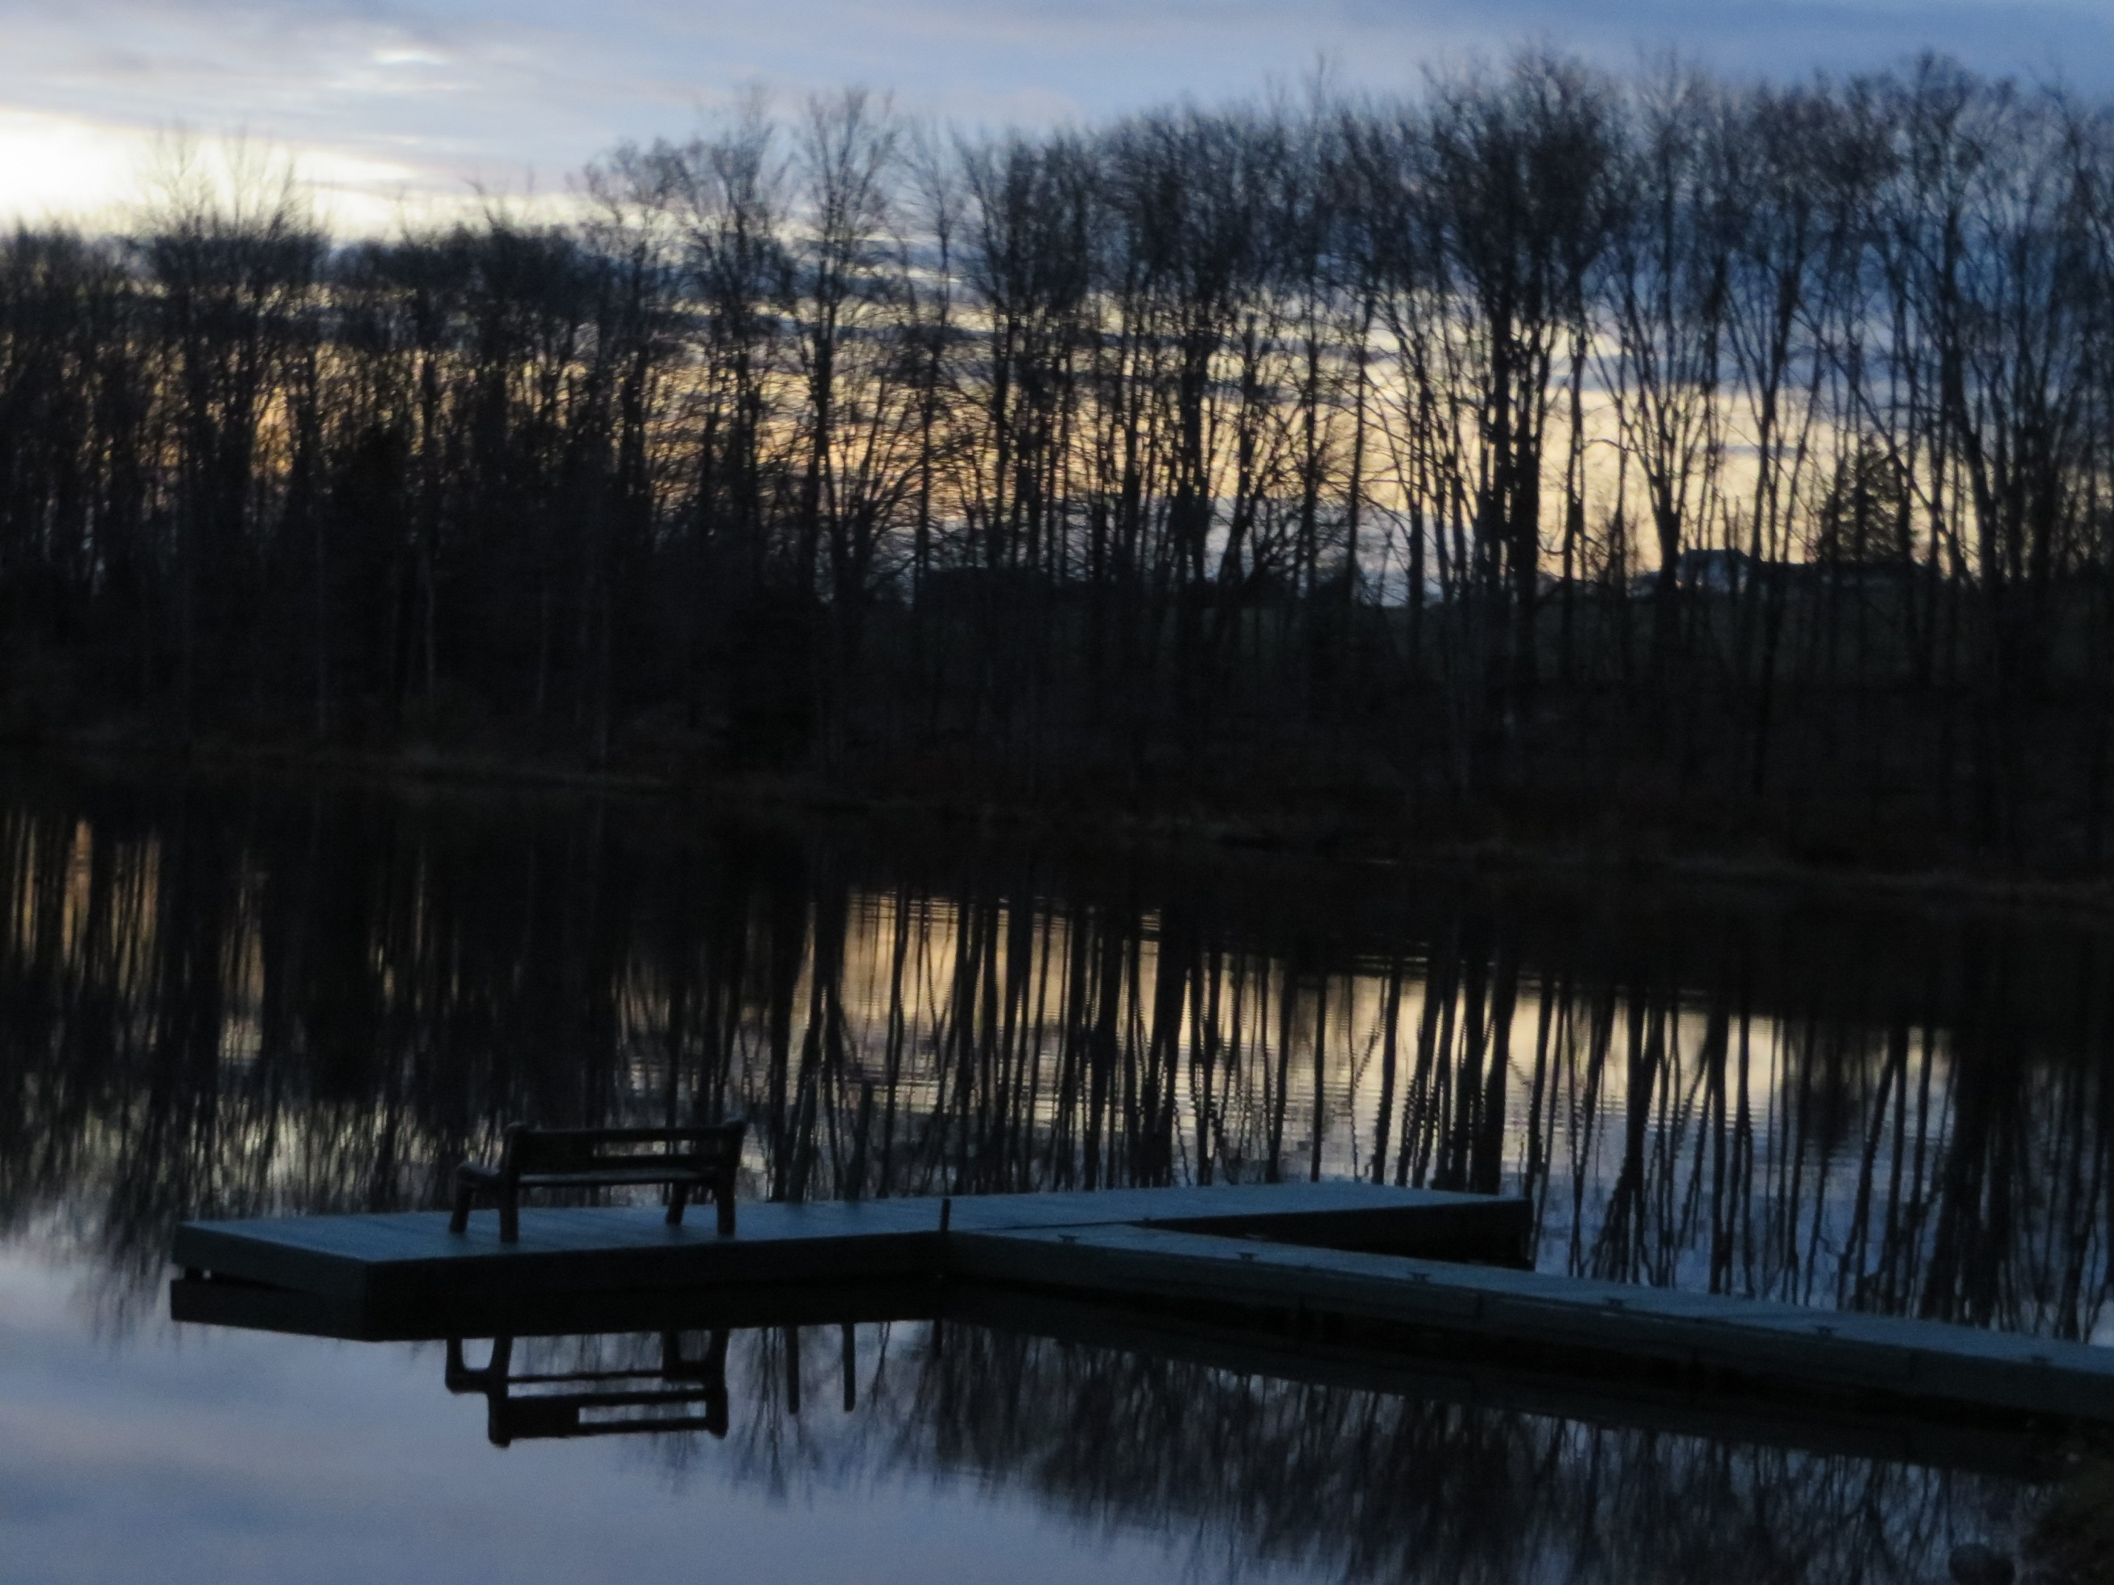
Arboretum at Sunrise in November

Slide 44
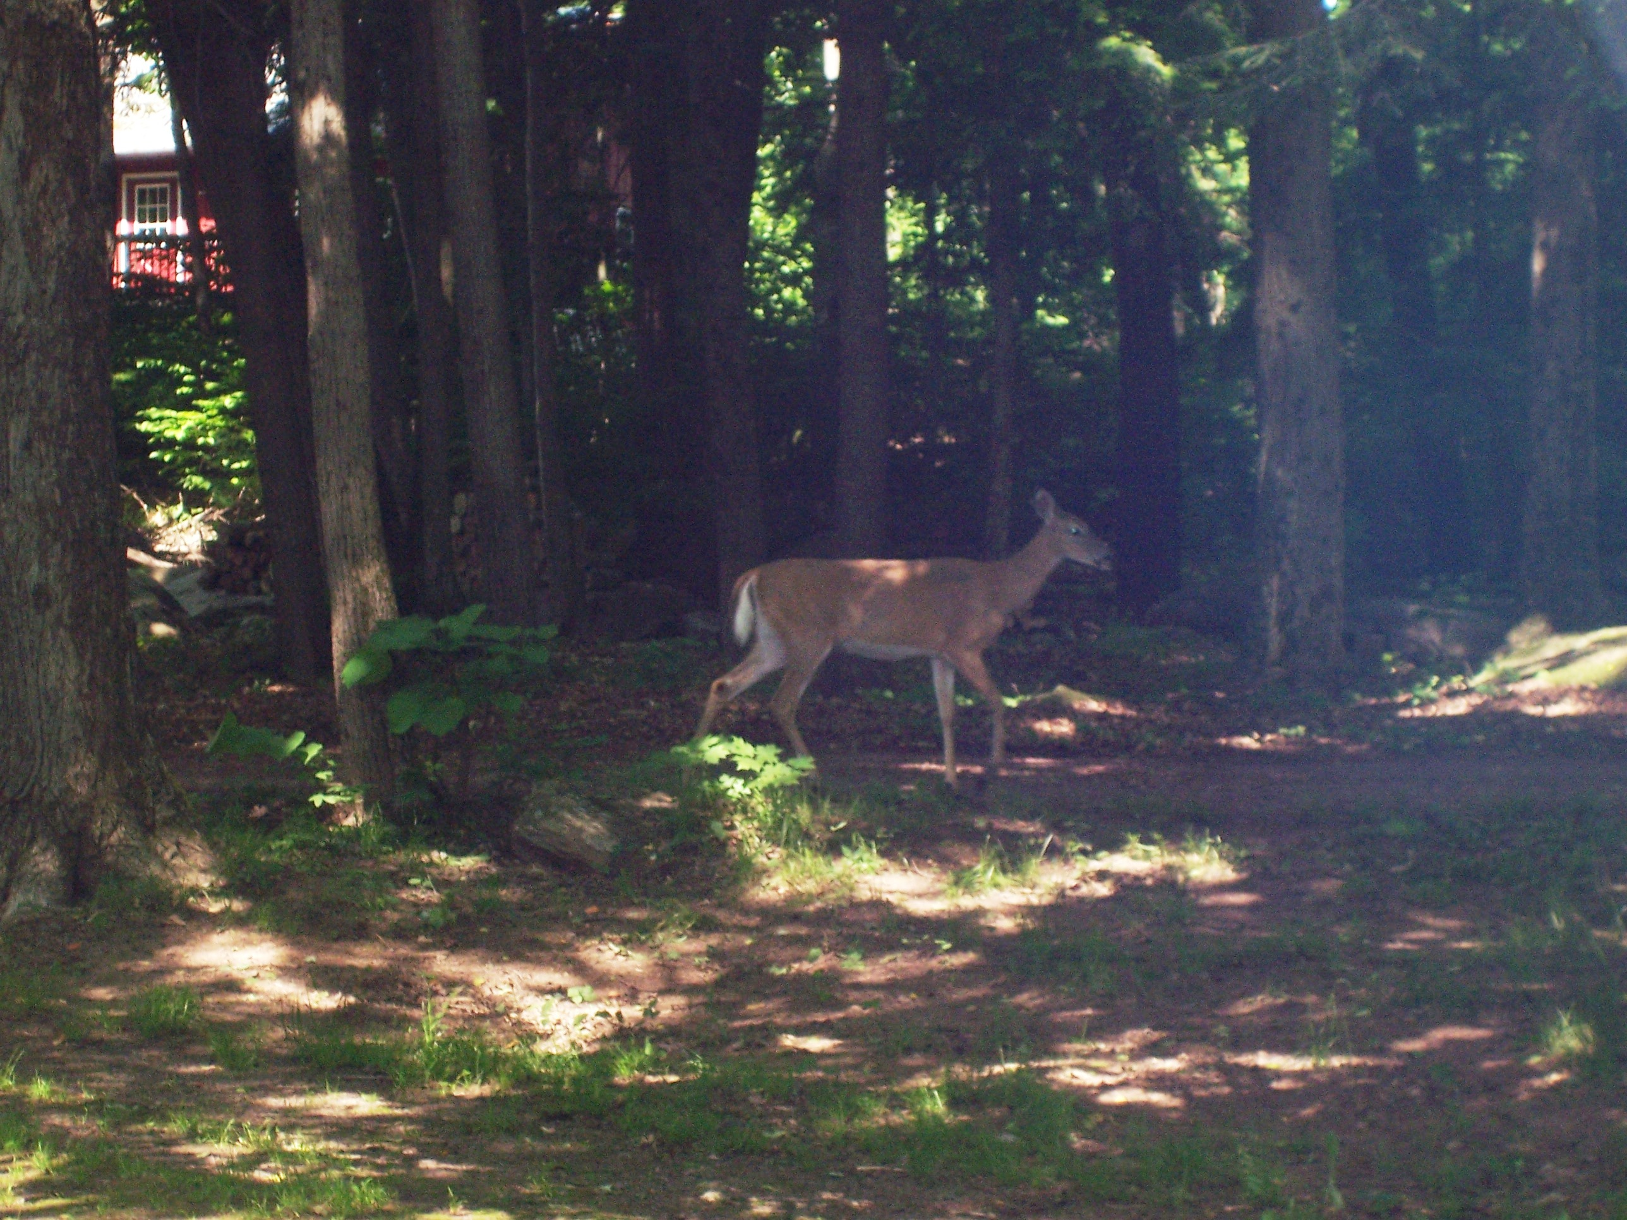

Slide 45
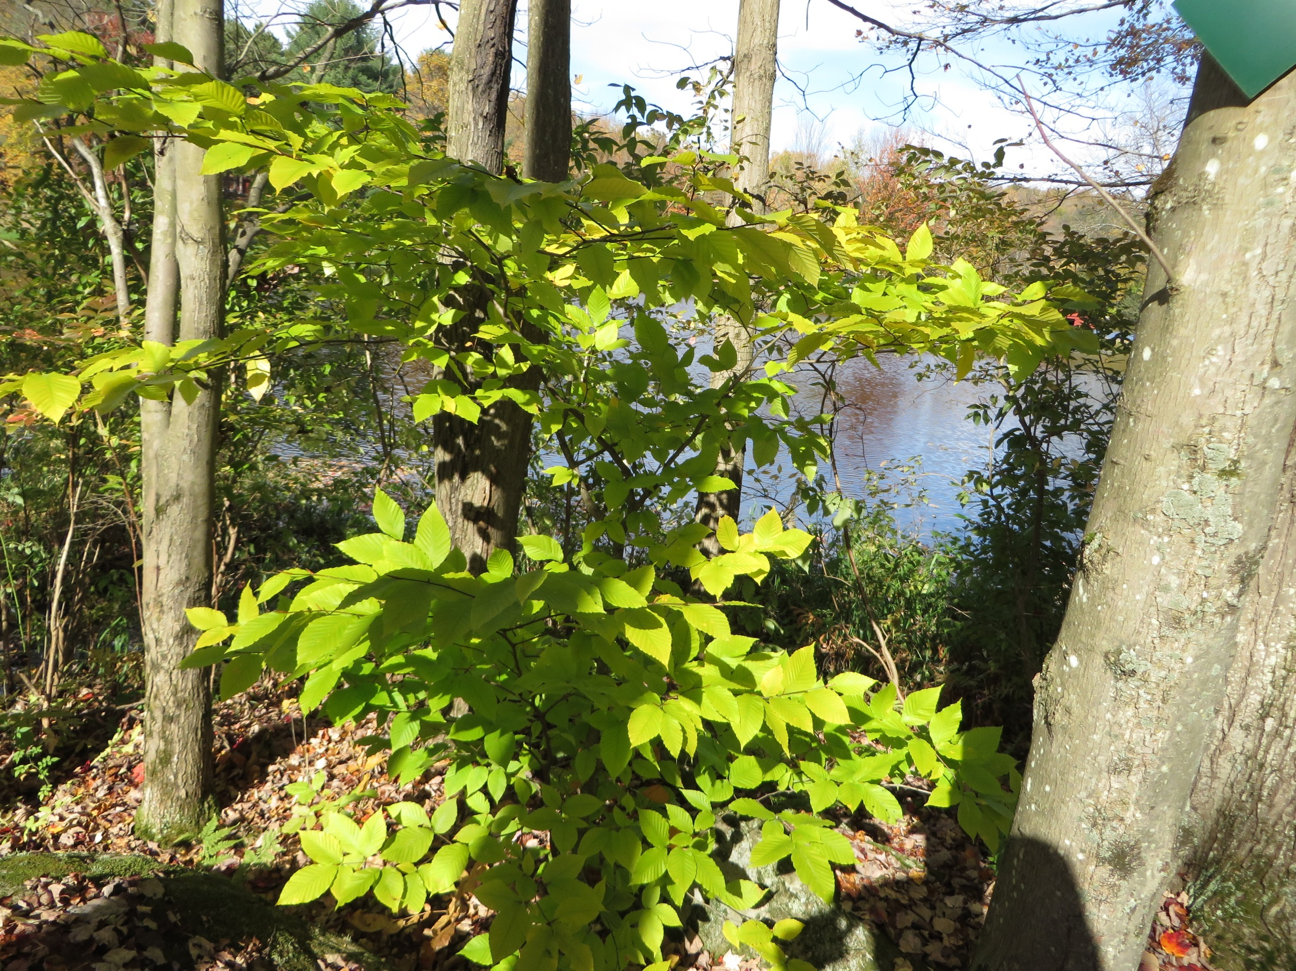

Slide 46
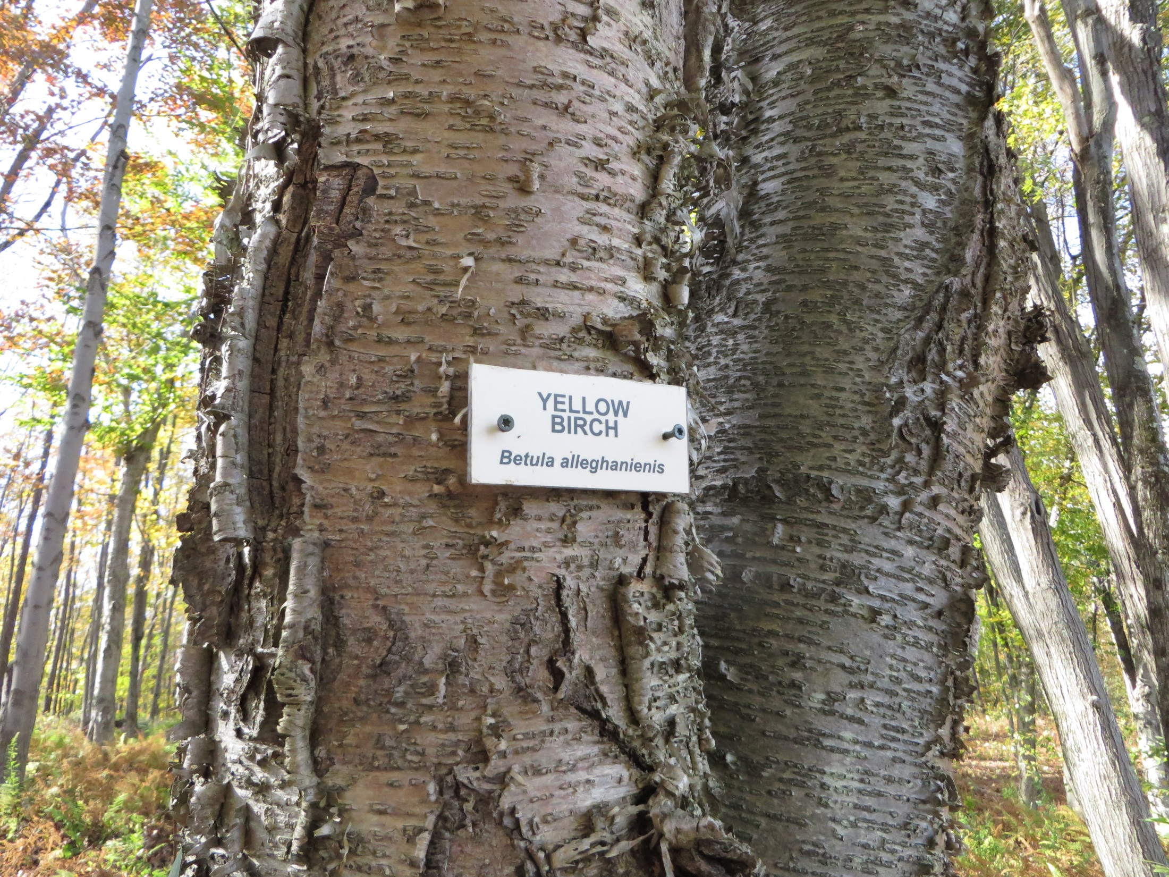

Slide 47
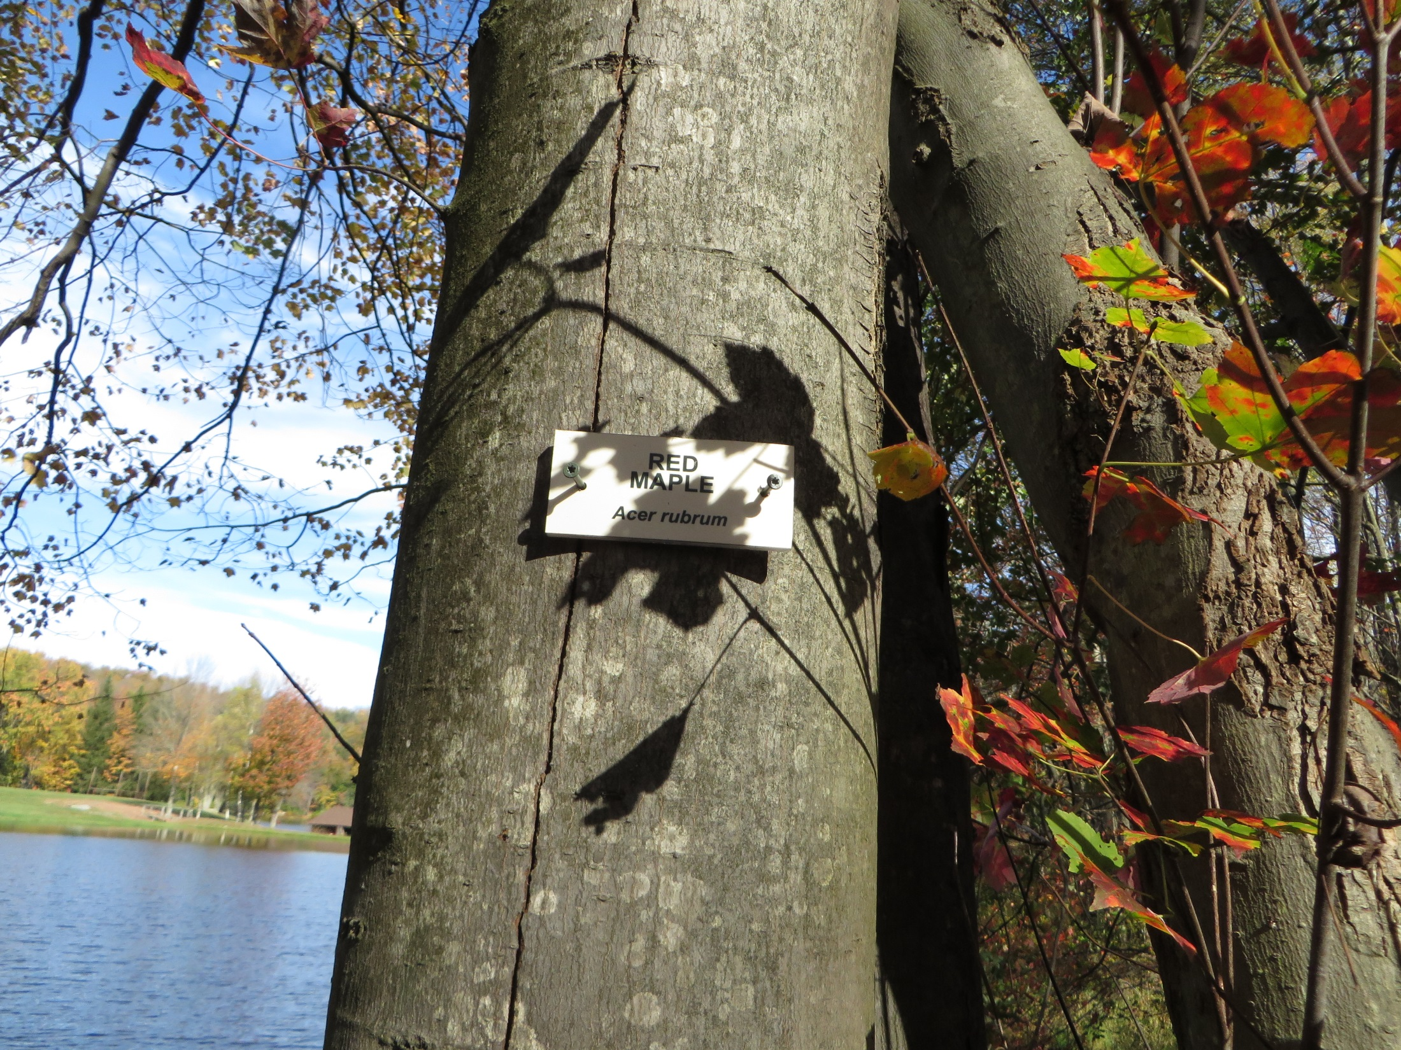

Slide 48


Slide 49


Slide 50


Slide 51


Slide 52

Arboretum Stone Wall
South edge of Arboretum

Slide 53

G. Plants of the Arboretum

Slide 54




1. Deciduous Trees – leaves fall in Fall
The Most Common Examples in the Arboretum

Slide 55




Deciduous Trees

Slide 56
2. Coniferous Trees (Evergreens)
The Most Common Examples in the Arboretum
  Hemlock - most common evergreen at CT, ½”needles long;
  3/4” cones, native, found along lake shore.
  b. White pine – needles 2.5-5” long, in packages of 5, cones 4- 8”, cluster of 6 at south east corner of pond dam, native.
  Norway spruce - needles singly, 4 sided, ¾” long; cones 4-7”;
  cluster of 10 near middle of arboretum stone wall,
  non-native i.e., planted.
  Mountain laurel – leaves (not needles) 2-4” long, only one in
  the arboretum and 2 at CT, can grow 9-27’ tall.

Slide 57




The Most Common Evergreens in the Arboretum

Slide 58

Hemlocks – Largest Trees at Camp

Slide 59

3. Lichen and Moss
Commonly grow on rocks
Lichen – composed of 2 plants: fungi which provides the structure and algae provides food.
Moss – small, soft, primitive plants in damp or shaded areas. Their leaves simply cover stems.
Lichen composed of very small areas of green algae within
the white fungus
Moss

Slide 60

Lichen
Mushrooms -
another type of Fungus
Moss
Lichen

Slide 61




H. Selected Animals:
1. Mammals Abridged from “Life at Camp Timberledge”

Slide 62





Slide 63





Slide 64




Slide 65
Literature and Website Resources
*www.camptimberledge.org
*Trails and Trees of Camp Timberledge.
*Camp Timberledge Trails.
*Check List of Animals and Plants at Camp Timberledge.
*Camp Timberledge Power Point of Camp Timberledge facilities.
*Life at Camp Timberledge Power Point of local animals and plants.
*Camp Timberledge Map.
Common Trees of Pennsylvania by PA Department of Conservation & Natural Resources: Bureau of Forestry.
Life, Places, and Things: A Brief Lift for LT@CT July 2013

Slide 66
The End

